Slide 1
Sociology 20033 Introduction to Social Problems
Opening day questions
Many of these feature a Notre Dame or South Bend Area Connection.

Slide 2
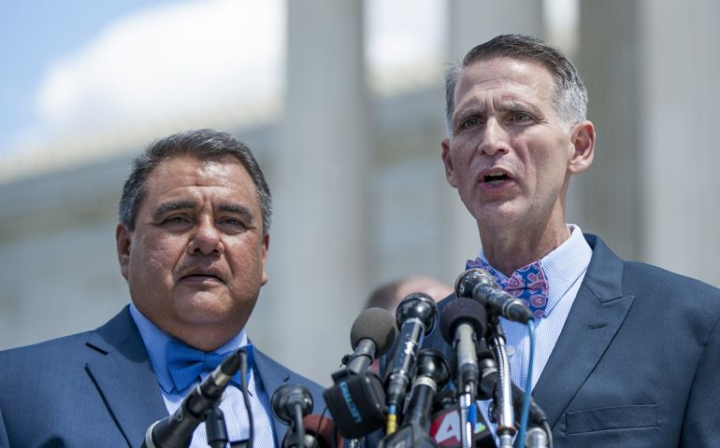
In 2014, National Catholic Reporter named Pope Francis as its Person of the Year. In 2015, Michael DeLeone and Notre Dame Sociology graduate Greg Bourke were named co-winners of the same award. Why were Bourke and DeLeone honored? Here is the award announcement.

Slide 3
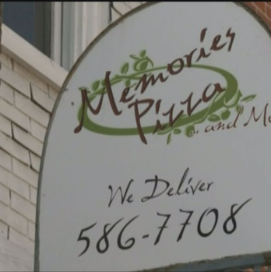
In April 2015 Memories Pizza in Walkerton, Indiana received more than $800,000 in donations from across the country. What had it done to attract both nationwide praise and condemnation? Read the details here.

Slide 4
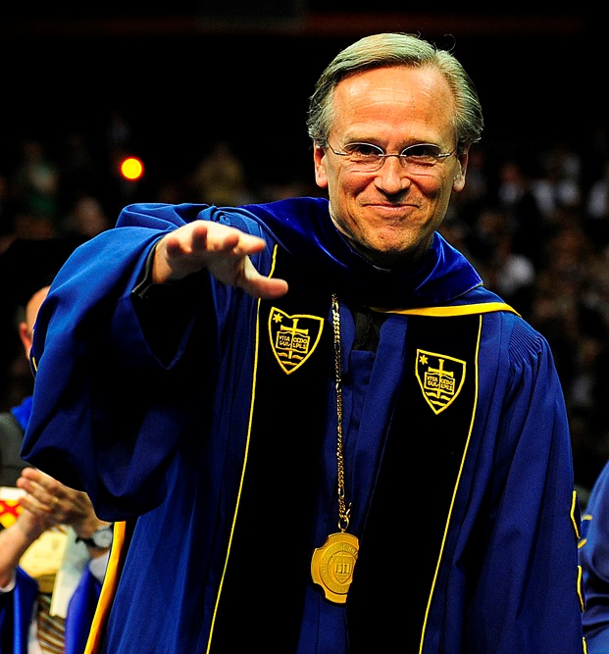
Why did Bishop Fabian W. Bruskewitz of Lincoln say that he was "utterly appalled" by the Omaha native pictured here?
What caused Professor Ralph McInerny to claim that Notre Dame had forfeited its right to call itself a Catholic university?
See their reasons here and here.

Slide 5
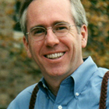
In a 2004 op-ed piece in the New York Times, then-Dean of Notre Dame’s College of Arts and Letters Mark Roche declared that “History will judge our society's support of abortion in much the same way we view earlier generations' support of torture and slavery - it will be universally condemned.” What did Roche urge Catholics to do in the 2004 Presidential race? Here is Roche’s op-ed.

Slide 6
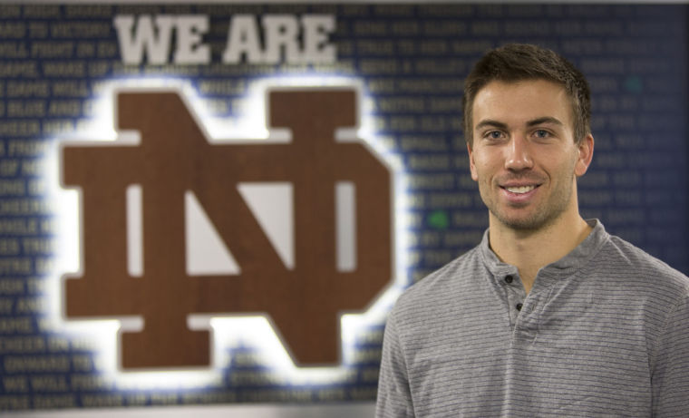
In 2014, Notre Dame Athletics released a video called “If you can play you can play.” What was it about? See the video
and read the story behind it.

Slide 7
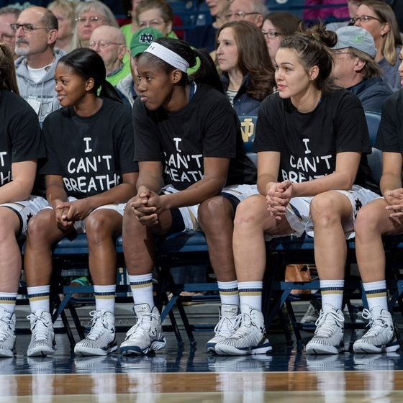
Who are these women? Why are they wearing these shirts?
What happened after they did?
Watch this video if you want to see what they were protesting. Click here to see some of feedback they received.

Slide 8
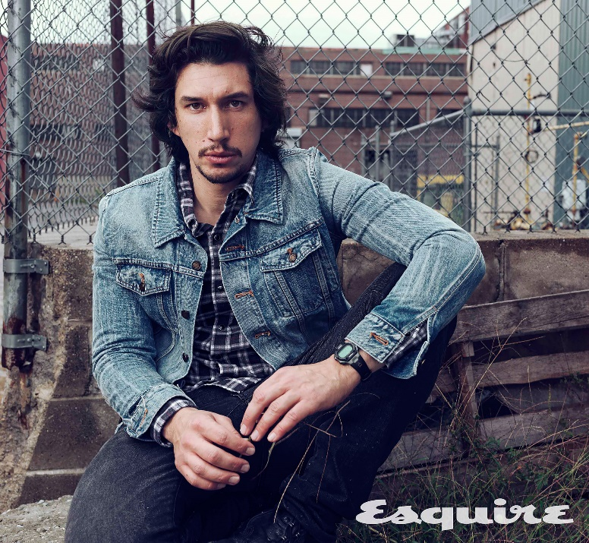
Adam Driver, co-star of BlacKkKlansman, claims that when he was a kid, “there were always Klan rallies, like, every summer. There were people in the Klan in our neighborhood.“ Where did Driver grow up at? And do the facts support him? The story is here.

Slide 9

An incident involving Notre Dame is featured in the documentary film The Hunting Ground. Why?
For some radically different reactions (including one of the most scathing attacks on Notre Dame I have ever read), click here and here.

Slide 10
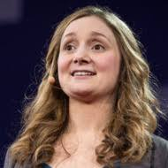
Alice Goffman wrote On the Run. What race is she? What is her book about, and why is she so controversial? The Chronicle of Higher Education covers the controversy.

Slide 11
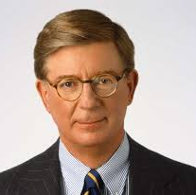
In March 2018 columnist George Will accused this country of genocide, saying it was systematically and deliberately attempting to erase an entire category of people. What country and what group of people was he referring to? And why is this issue so personally relevant to him? See Will’s op-ed here.

Slide 12
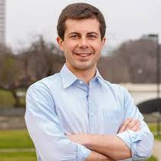
Many people predict that this Harvard graduate, Rhodes Scholar, and military veteran will be the first openly gay president of the United States. Who is he, and what political office does he currently hold? Read more about him here and watch a video of him at an LGBTQ event.

