Slide 1
The bo-Adams spectral sequence
Mark Behrens (Notre Dame)
Joint with Agnes Beaudry (Uchicago), Prasit Bhattacharya (Notre Dame), Dominic Culver (Notre Dame), Zhouli Xu (Uchicago)

Slide 2
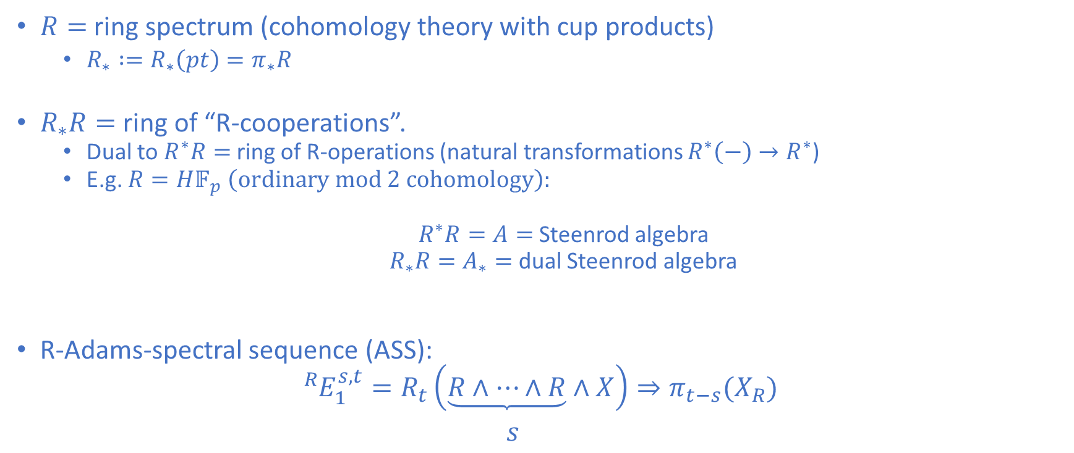
Generalized Adams spectral sequences
$R=$ ring spectrum (cohomology theory with cup products)
  $R_{∗} :=R_{∗}\left(pt\right)=π_{∗}R$
$R_{∗}R=$ ring of “R-cooperations”.
  Dual to $R^{∗}R=$ ring of R-operations (natural transformations $R^{∗}\left(−\right)→R^{∗}$)
  E.g. $R=H𝔽_{p} \left(ordinary mod 2 cohomology\right):$
  $R^{∗}R=A=$ Steenrod algebra
  $R_{∗}R=A_{∗}=$ dual Steenrod algebra
R-Adams-spectral sequence (ASS):
$${{}_{ }^{R}{E_{1}^{s,t}=}R}_{t}\left(\underbrace{R∧⋯∧R}∧X\right)⇒π_{t−s}{(X}_{R})$$
$s$

Slide 3
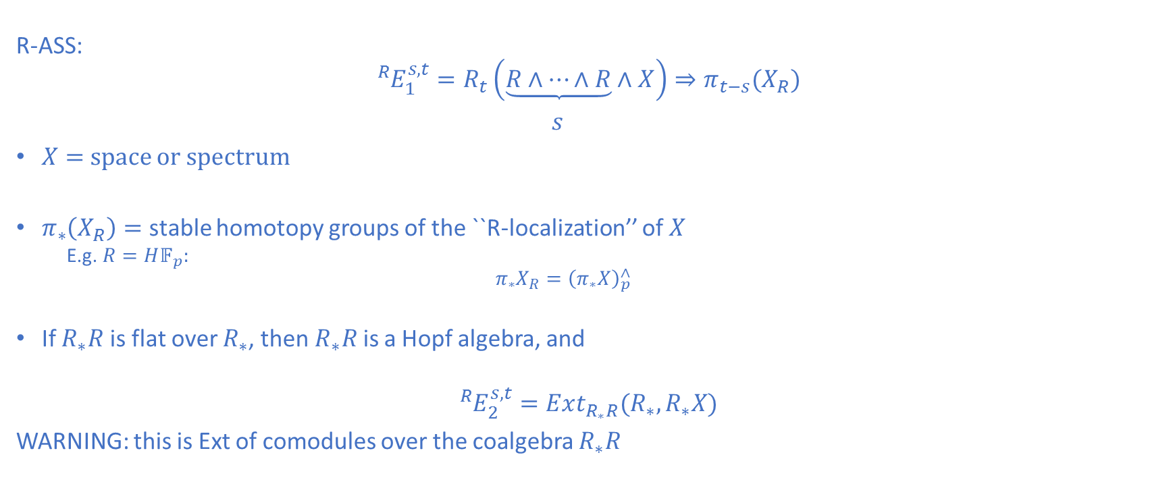
Generalized Adams spectral sequences
R-ASS:
$${{}_{ }^{R}{E_{1}^{s,t}=}R}_{t}\left(\underbrace{R∧⋯∧R}∧X\right)⇒π_{t−s}{(X}_{R})$$
$s$
$X=$space or spectrum
$π_{∗}\left(X_{R}\right)=$ stable homotopy groups of the ``R-localization’’ of $X$
  E.g. $R=H𝔽_{p}:$
  $$π_{∗}X_{R}={\left(π_{∗}X\right)}_{p}^{∧}$$
If $R_{∗}R$ is flat over $R_{∗}$, then $R_{∗}R$ is a Hopf algebra, and
$${{}_{ }^{R}E}_{2}^{s,t}=Ext_{R_{∗}R}(R_{∗},R_{∗}X)$$
WARNING: this is Ext of comodules over the coalgebra $R_{∗}R$

Slide 4
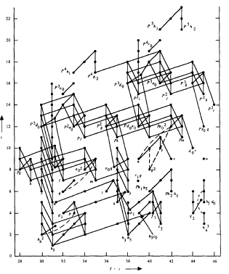
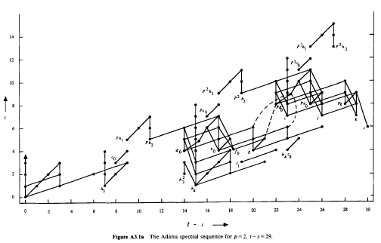
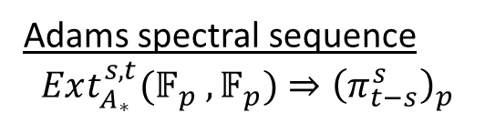
Adams spectral sequence
$$Ext_{A_{∗}}^{s,t}(𝔽_{p} ,𝔽_{p})⇒{\left(π_{t−s}^{s}\right)}_{p}$$

Slide 5
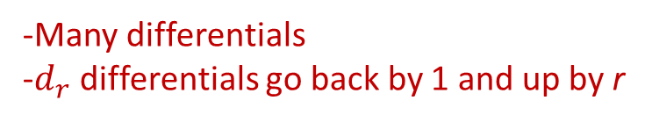
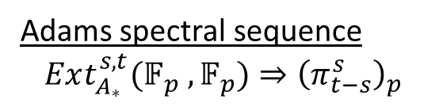
Adams spectral sequence
$$Ext_{A_{∗}}^{s,t}(𝔽_{p} ,𝔽_{p})⇒{\left(π_{t−s}^{s}\right)}_{p}$$
-Many differentials
-$d_{r}$ differentials go back by 1 and up by r

Slide 6
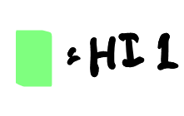
Adams spectral sequence
$$Ext_{A_{∗}}^{s,t}(𝔽_{p} ,𝔽_{p})⇒{\left(π_{t−s}^{s}\right)}_{p}$$
-Many differentials
-$d_{r}$ differentials go back by 1 and up by r
Notes:
HI(x) = 1 ⬄ x detected by h_i
D2(h_i)

Slide 7
Adams spectral sequence
$$Ext_{A_{∗}}^{s,t}(𝔽_{p} ,𝔽_{p})⇒{\left(π_{t−s}^{s}\right)}_{p}$$

Slide 8
Adams spectral sequence
$$Ext_{A_{∗}}^{s,t}(𝔽_{p} ,𝔽_{p})⇒{\left(π_{t−s}^{s}\right)}_{p}$$
Notes:
Kervaire Invariant
Browder ‘69
Barratt-Jones-Mahowald ’85
HHR ’09
Q: h_6^2 PC?
Q: d_r(h_i^2)?

Slide 9
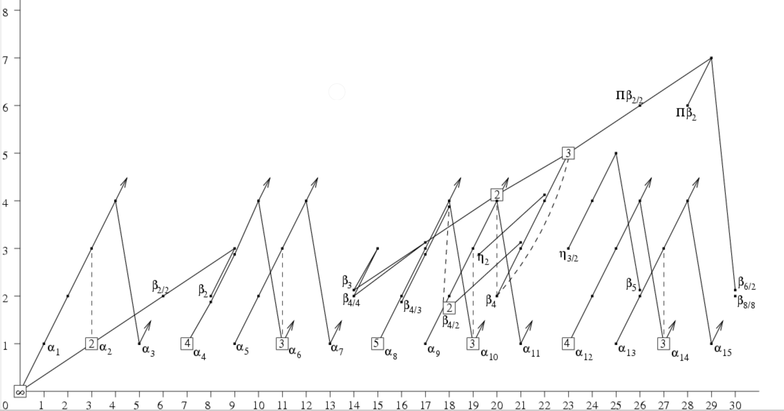
Adams-Novikov spectral sequence (p=2)
Notes:
ANSS
Pi_*BP

Slide 10
Adams-Novikov spectral sequence (p=2)

Slide 11
Adams-Novikov spectral sequence (p=2)

Slide 12
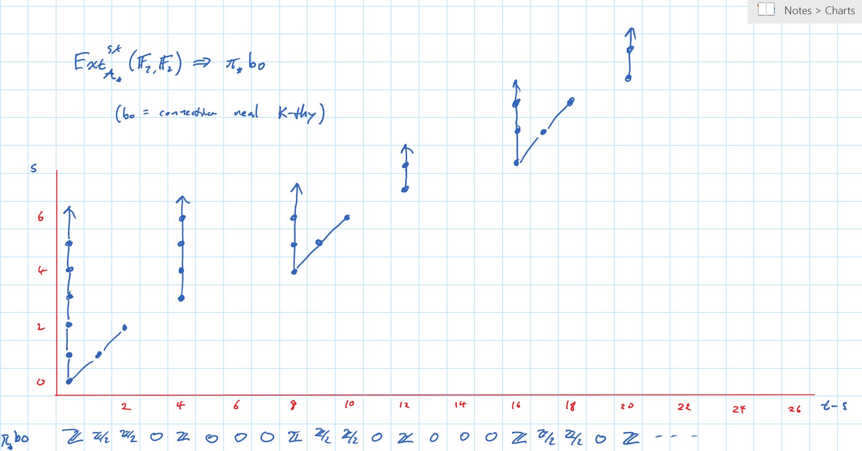

Slide 14
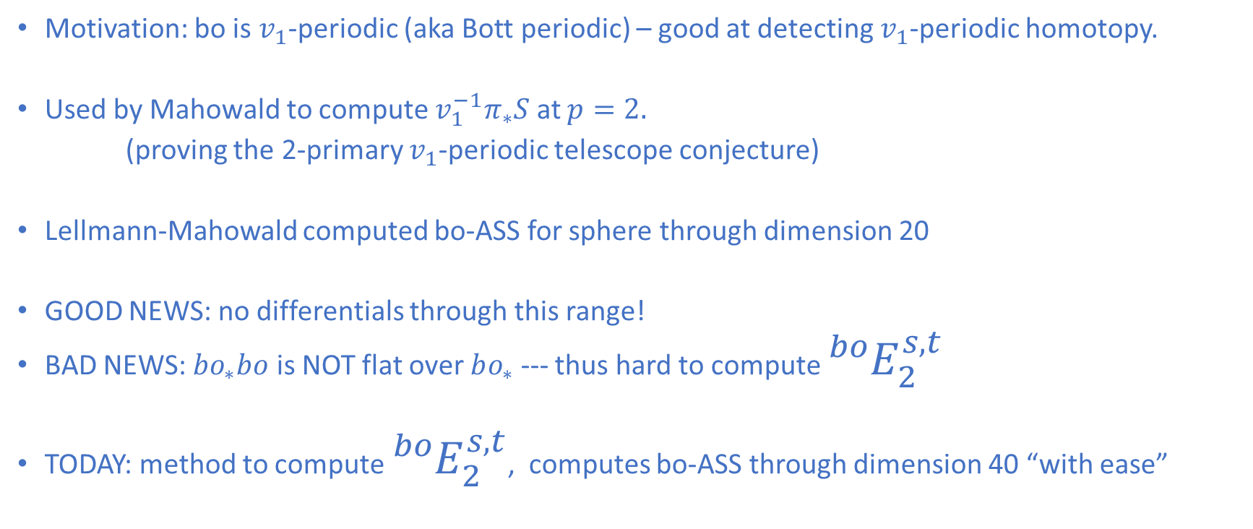
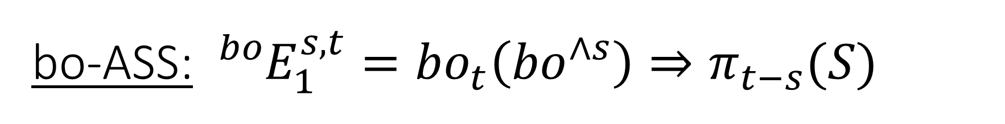
bo-ASS: ${{}_{ }^{bo}{E_{1}^{s,t}=}bo}_{t}\left({bo}^{∧s}\right)⇒π_{t−s}(S)$
Motivation: bo is $v_{1}$-periodic (aka Bott periodic) – good at detecting $v_{1}$-periodic homotopy.
Used by Mahowald to compute $v_{1}^{−1}π_{∗}S$ at $p=2.$
(proving the 2-primary $v_{1}$-periodic telescope conjecture)
Lellmann-Mahowald computed bo-ASS for sphere through dimension 20
GOOD NEWS: no differentials through this range!
BAD NEWS: $bo_{∗}bo$ is NOT flat over $bo_{∗}$ --- thus hard to compute ${}_{ }^{bo}{E_{2}^{s,t}}$
TODAY: method to compute ${}_{ }^{bo}{E_{2}^{s,t}}$, computes bo-ASS through dimension 40 “with ease”

Slide 15

The real motivation: tmf-ASS
tmf = topological modular forms (sees $v_{1}{ and v}_{2}$-periodic homotopy)
Much more powerful than bo

Slide 17
Adams spectral sequence
$$Ext_{A_{∗}}^{s,t}(𝔽_{p} ,𝔽_{p})⇒{\left(π_{t−s}^{s}\right)}_{p}$$

Slide 18
Adams spectral sequence
$$Ext_{A_{∗}}^{s,t}(𝔽_{p} ,𝔽_{p})⇒{\left(π_{t−s}^{s}\right)}_{p}$$

Slide 19
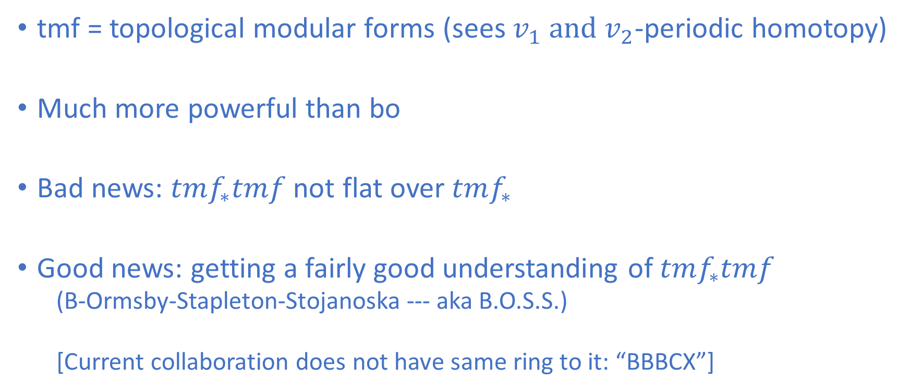
The real motivation: tmf-ASS
tmf = topological modular forms (sees $v_{1}{ and v}_{2}$-periodic homotopy)
Much more powerful than bo
Bad news: $tmf_{∗}tmf$ not flat over $tmf_{∗}$
Good news: getting a fairly good understanding of $tmf_{∗}tmf$
  (B-Ormsby-Stapleton-Stojanoska --- aka B.O.S.S.)
  [Current collaboration does not have same ring to it: “BBBCX”]

Slide 20
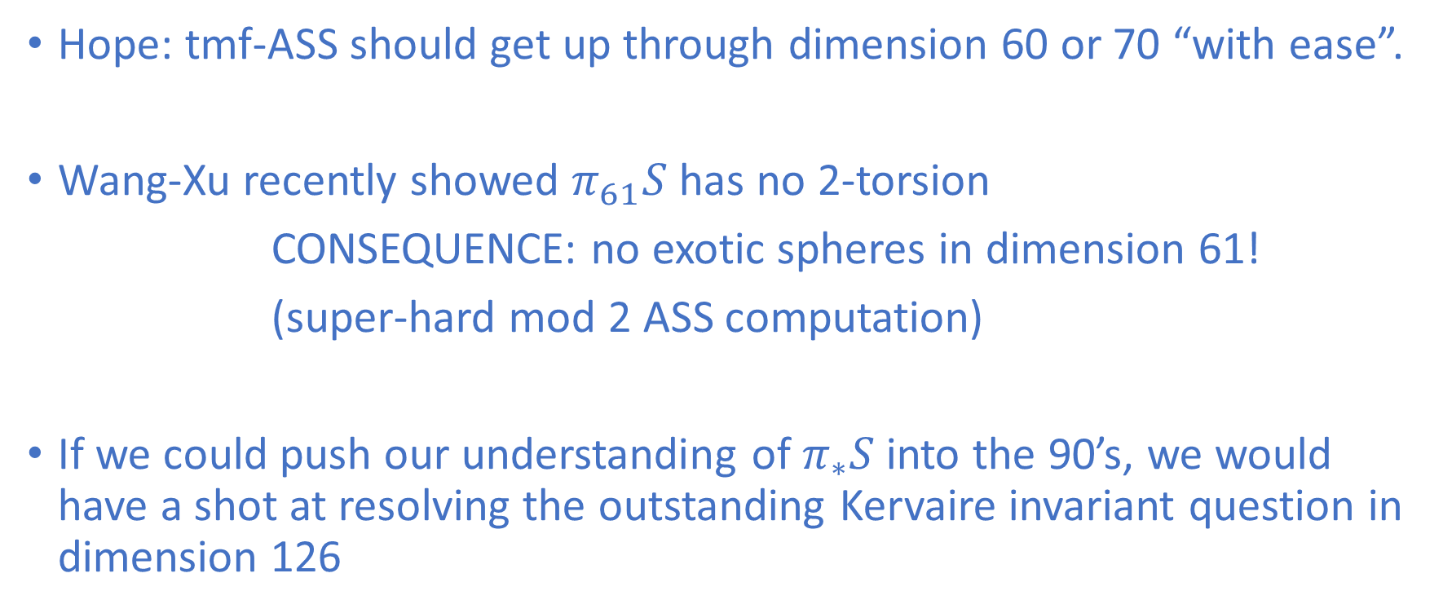
The real motivation: tmf-ASS
Hope: tmf-ASS should get up through dimension 60 or 70 “with ease”.
Wang-Xu recently showed $π_{61}S$ has no 2-torsion
CONSEQUENCE: no exotic spheres in dimension 61!
(super-hard mod 2 ASS computation)
If we could push our understanding of $π_{∗}S$ into the 90’s, we would have a shot at resolving the outstanding Kervaire invariant question in dimension 126

Slide 21
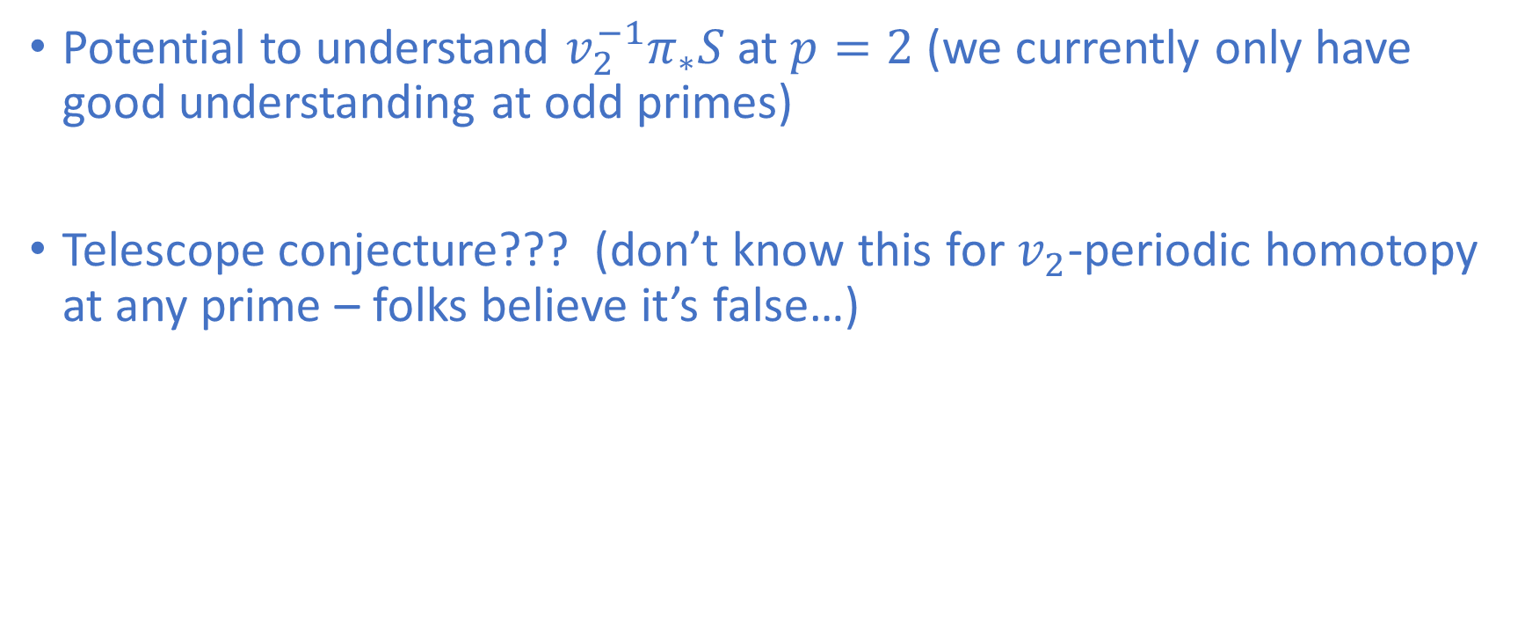
The real motivation: tmf-ASS
Potential to understand $v_{2}^{−1}π_{∗}S$ at $p=2$ (we currently only have good understanding at odd primes)
Telescope conjecture??? (don’t know this for $v_{2}$-periodic homotopy at any prime – folks believe it’s false…)

Slide 22
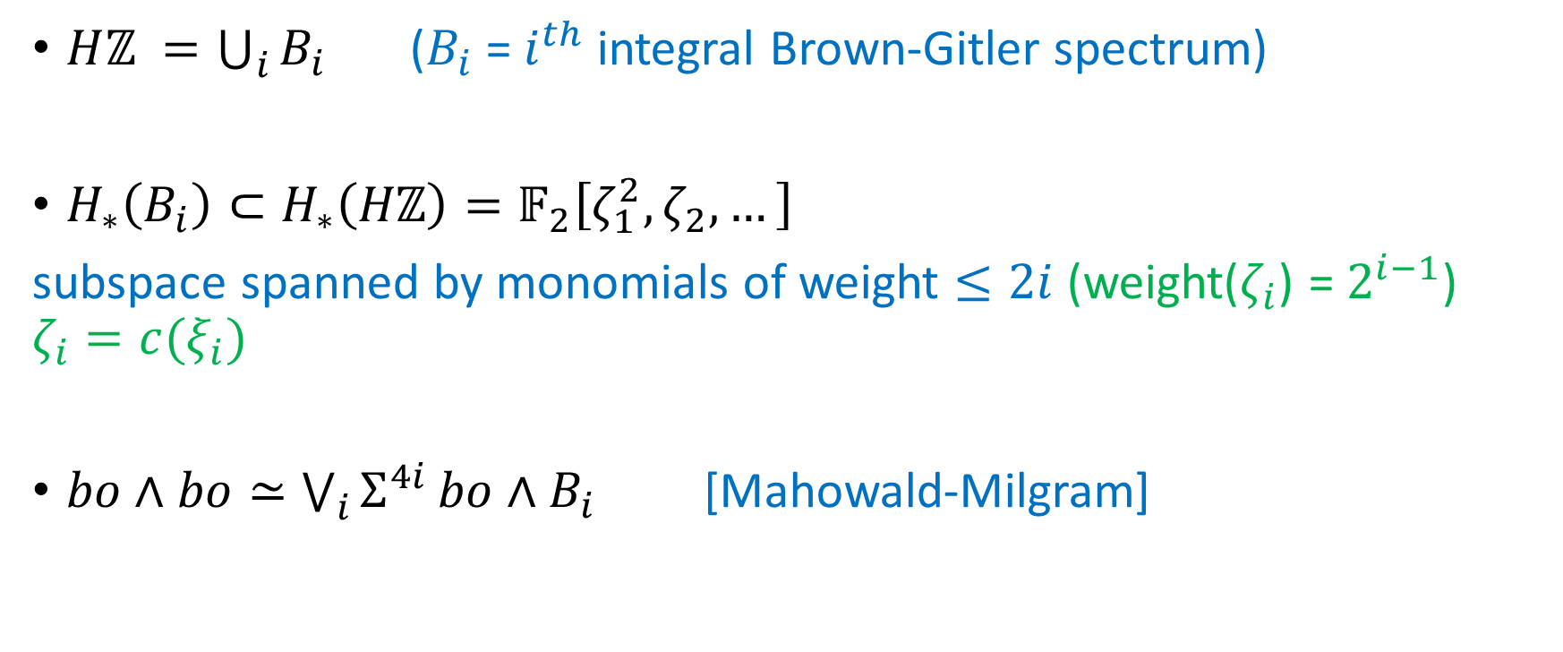
Connective K-theory cooperations
Brown-Gitler spectrum perspective
$Hℤ_{ }={\bigcup_{i}{B_{i}}}_{ }$ ($B_{i}$ = $i^{th}$ integral Brown-Gitler spectrum)
$H_{∗}\left(B_{i}\right)⊂H_{∗}\left(Hℤ\right)=𝔽_{2}\left[ζ_{1}^{2},ζ_{2}, …\right]$
subspace spanned by monomials of weight $≤2i$ (weight($ζ_{i}$) = $2^{i−1}$)
$$ζ_{i}={c(ξ}_{i})$$
$bo∧bo≃\bigvee_{i}{Σ^{4i}}bo∧B_{i}$ [Mahowald-Milgram]

Slide 23

Connective K-theory cooperations
Brown-Gitler spectrum perspective
$bo∧bo^{s}≃\bigvee_{I=\left(i_{1}, …, i_{s}\right)}{Σ^{4\left|I\right|}}bo∧B_{I}$
  $B_{I}=B_{i_{1}}∧⋯∧B_{i_{s}}$
  $\left|I\right|=i_{1}+⋯+i_{s}$
$bo∧B_{I}≃HV_{I}∨\left\{\begin{aligned}bo^{<2\left|I\right|−α\left(I\right)>}, \left|I\right| even \\ bsp^{<2\left|I\right|−α\left(I\right)−1>}, \left|I\right| odd\end{aligned}\right.$
  $V_{I}=$ graded $𝔽_{2}$-vector space
  $α\left(i\right)=$ number of 1’s in dyatic expansion of i
  $α\left(I\right)=α\left(i_{1}\right)+⋯+α(i_{s})$
  $bo^{<n>}=n$th Adams cover of bo (bsp = symplectic K-theory)

Slide 24
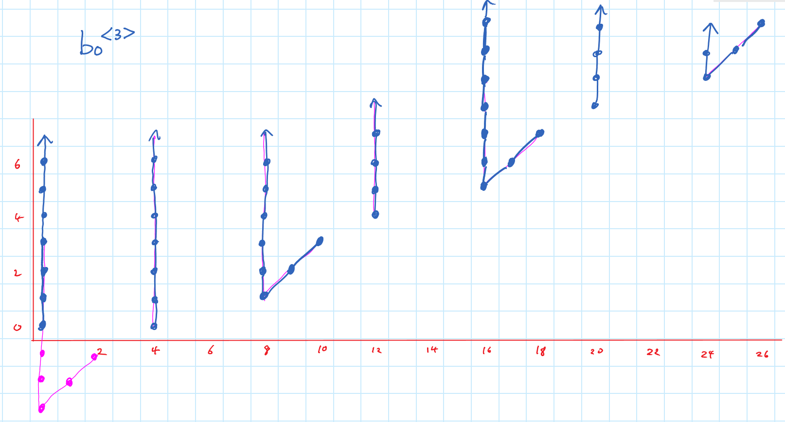

Slide 25
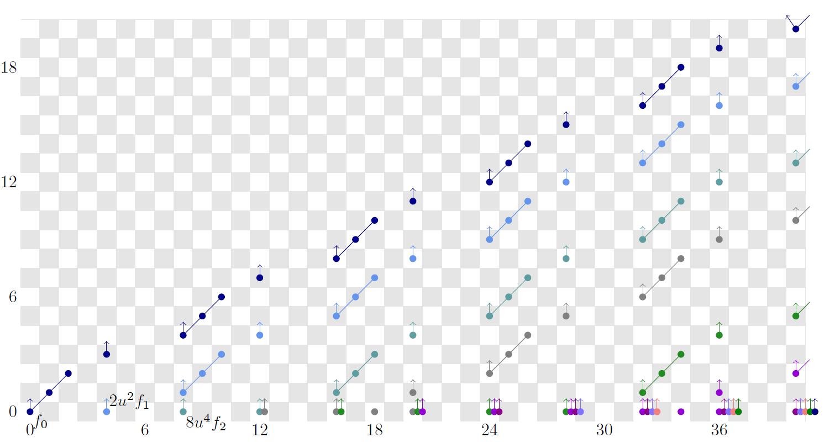
Adams spectral sequence for “good” part of $bo∧bo$

Slide 26

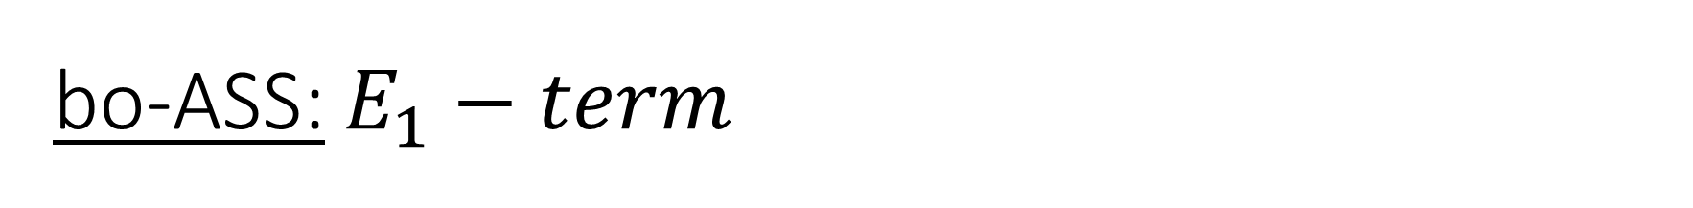
bo-ASS: $E_{1}−term$
$${}_{ }^{bo}{E_{1}^{s,t}=}bo_{t}bo^{s}≃⨁_{I=\left(i_{1}, …, i_{s}\right)}{V_{I}⊕}\left\{\begin{aligned}π_{t}Σ^{4\left|I\right|}bo^{<2\left|I\right|−α\left(I\right)>}, \left|I\right| even \\ π_{t}Σ^{4\left|I\right|}bsp^{<2\left|I\right|−α\left(I\right)−1>}, \left|I\right| odd\end{aligned}\right.$$

Slide 27
bo-ASS: $E_{1}−term$
$${}_{ }^{bo}{E_{1}^{s,t}=}bo_{t}bo^{s}≃⨁_{I=\left(i_{1}, …, i_{s}\right)}{V_{I}⊕}\left\{\begin{aligned}π_{t}Σ^{4\left|I\right|}bo^{<2\left|I\right|−α\left(I\right)>}, \left|I\right| even \\ π_{t}Σ^{4\left|I\right|}bsp^{<2\left|I\right|−α\left(I\right)−1>}, \left|I\right| odd\end{aligned}\right.$$

Slide 28
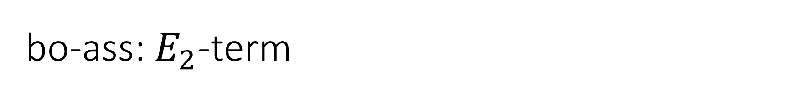
bo-ass: $E_{2}$-term

Slide 29
bo-ass: $E_{2}$-term

Slide 30

Our contribution: can use $Ext_{A_{∗}}\left(𝔽_{2},𝔽_{2}\right)$ to compute ${}_{ }^{evil}{E_{2}^{∗,∗}}$ directly!

Slide 31
Our contribution: can use $Ext_{A_{∗}}\left(𝔽_{2},𝔽_{2}\right)$ to compute ${}_{ }^{evil}{E_{2}^{∗,∗}}$ directly!

Slide 32
Our contribution: can use $Ext_{A_{∗}}\left(𝔽_{2},𝔽_{2}\right)$ to compute ${}_{ }^{evil}{E_{2}^{∗,∗}}$ directly!

Slide 37
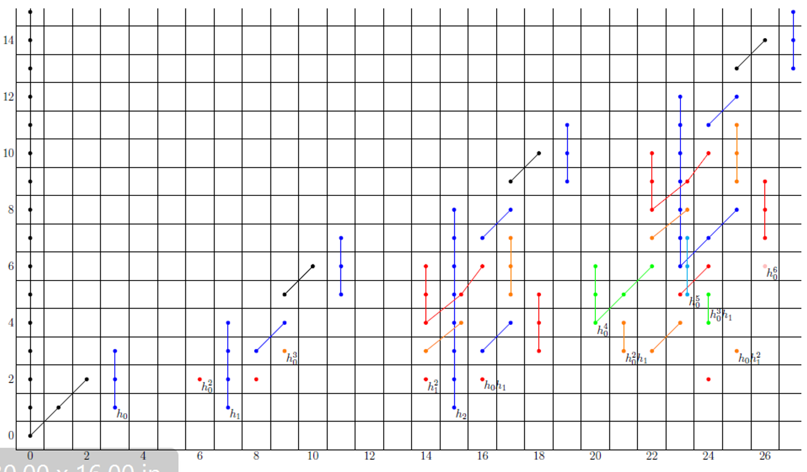

Slide 38
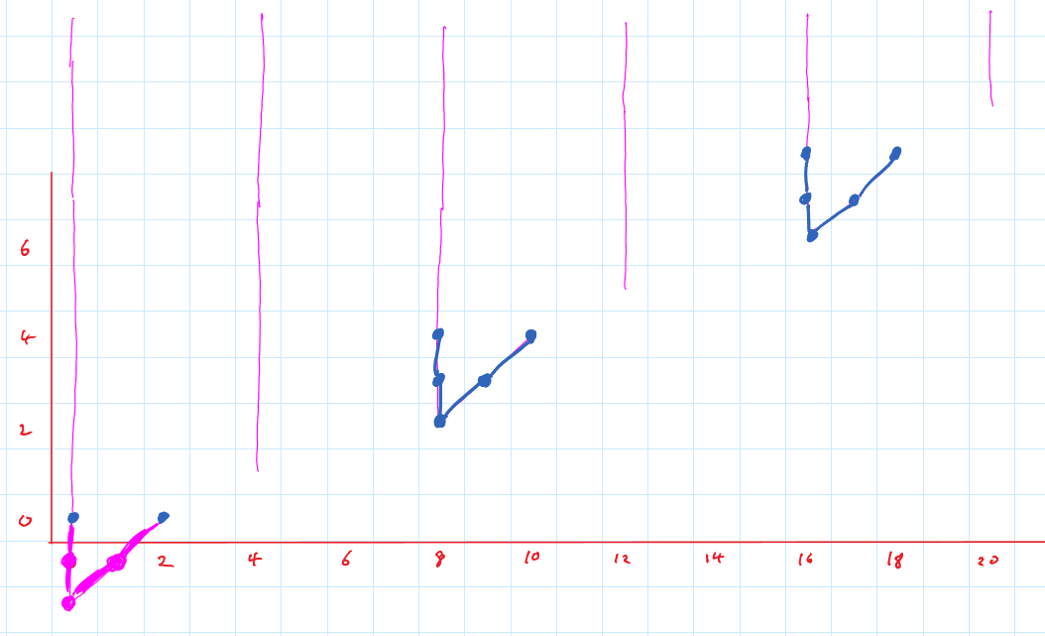

Slide 40
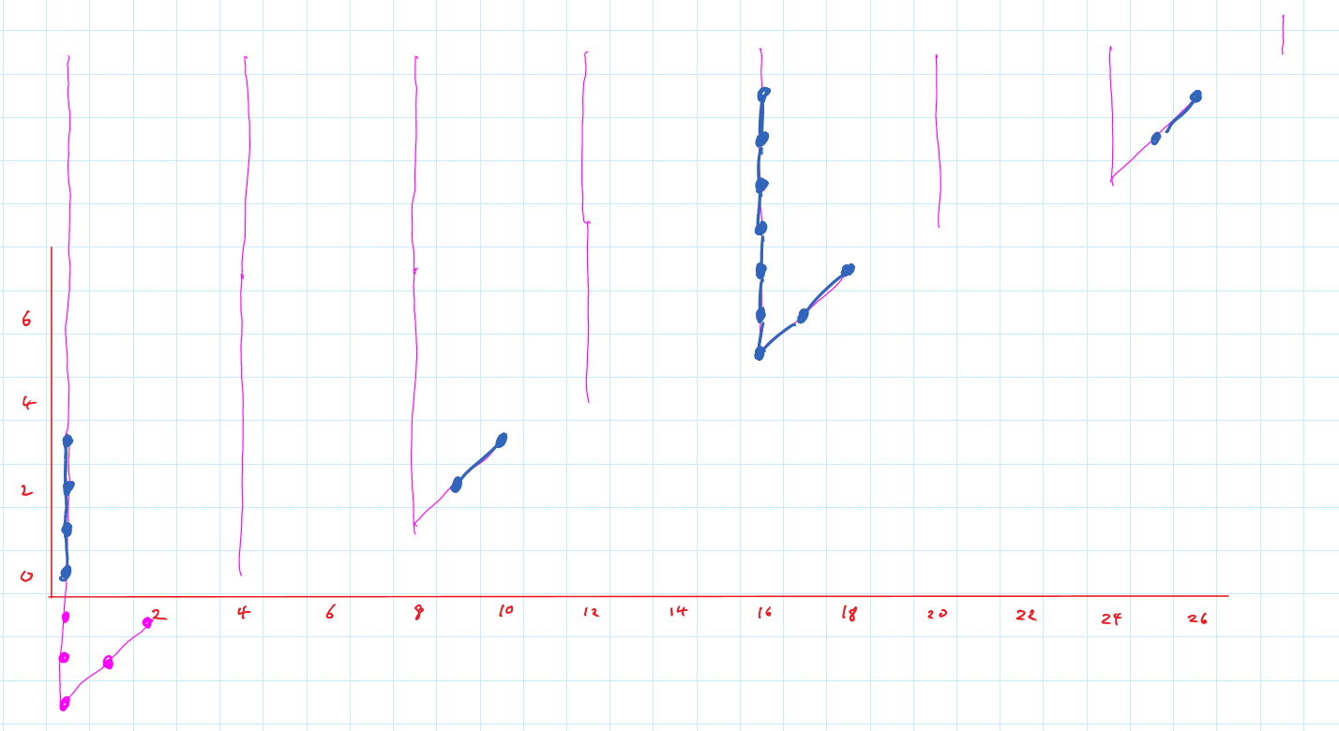

Slide 42
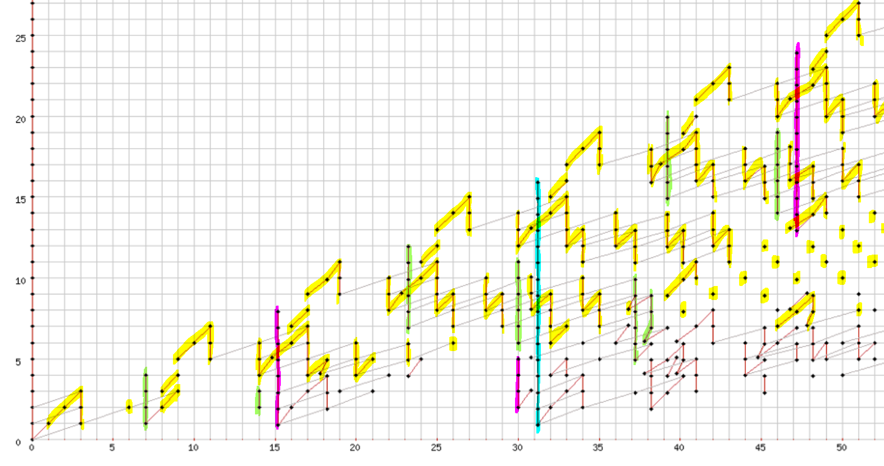

Slide 48
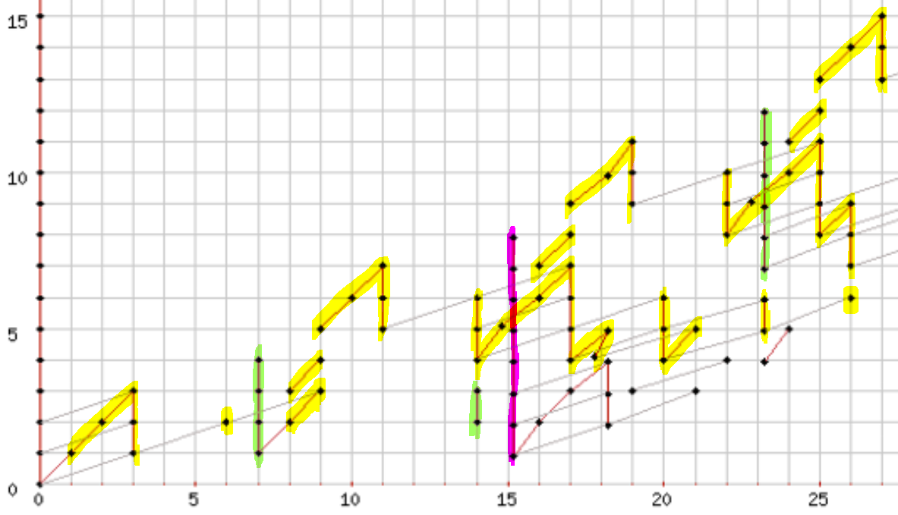

Slide 49
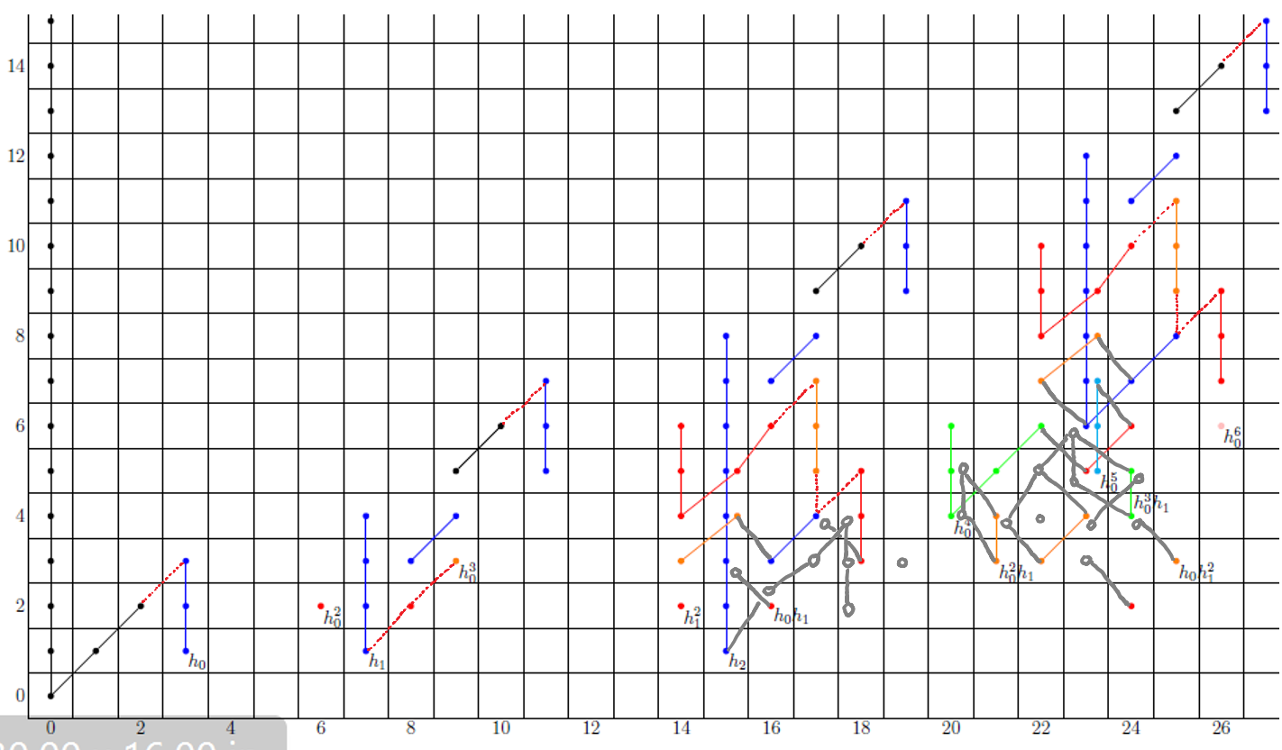

Slide 50
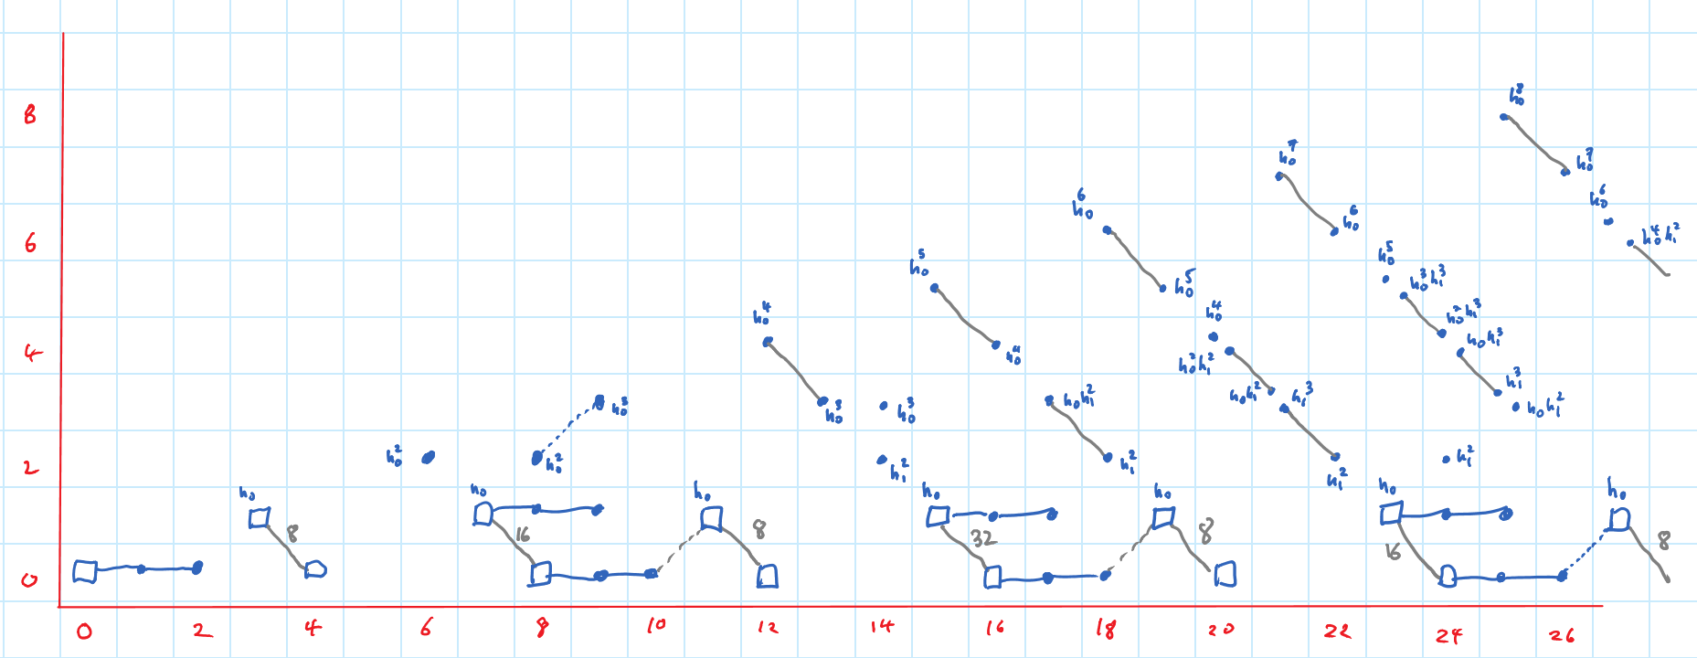

Slide 51
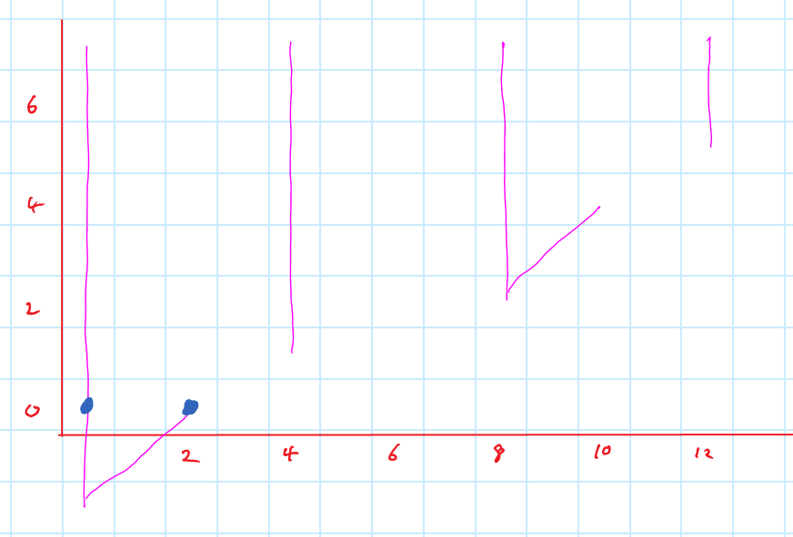

Slide 53
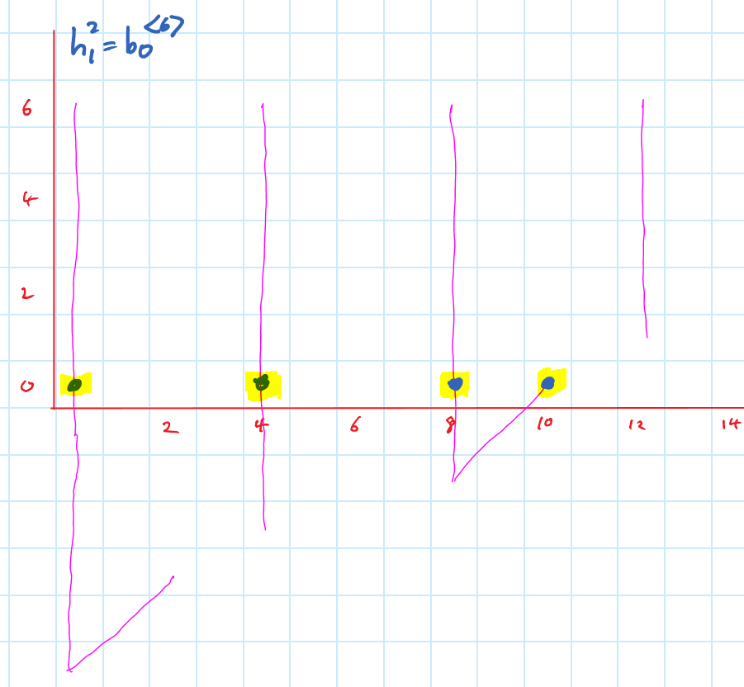

Slide 55
