Slide 1
Exotic spheres and topological modular forms
Mark Behrens (MIT)
(joint with Mike Hill, Mike Hopkins, and Mark Mahowald)

Slide 2
Fantastic survey of the subject:
Milnor, “Differential topology: 46 years later”
(Notices of the AMS, June/July 2011)
http://www.ams.org/notices/201106/

Slide 3
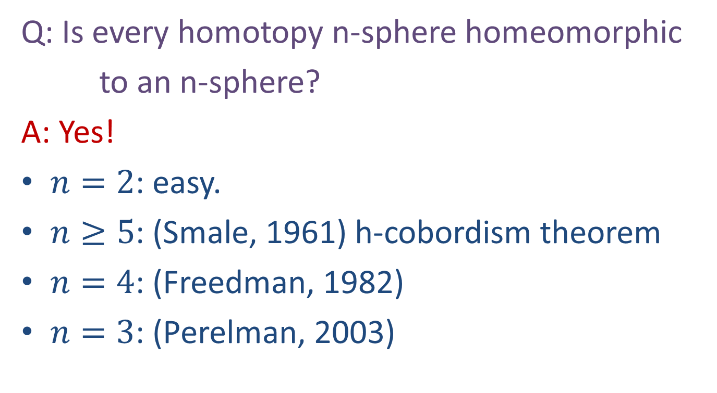
Poincaré Conjecture
Q: Is every homotopy n-sphere homeomorphic
to an n-sphere?
A: Yes!
$n=2$: easy.
$n≥5$: (Smale, 1961) h-cobordism theorem
$n=4$: (Freedman, 1982)
$n=3$: (Perelman, 2003)

Slide 4
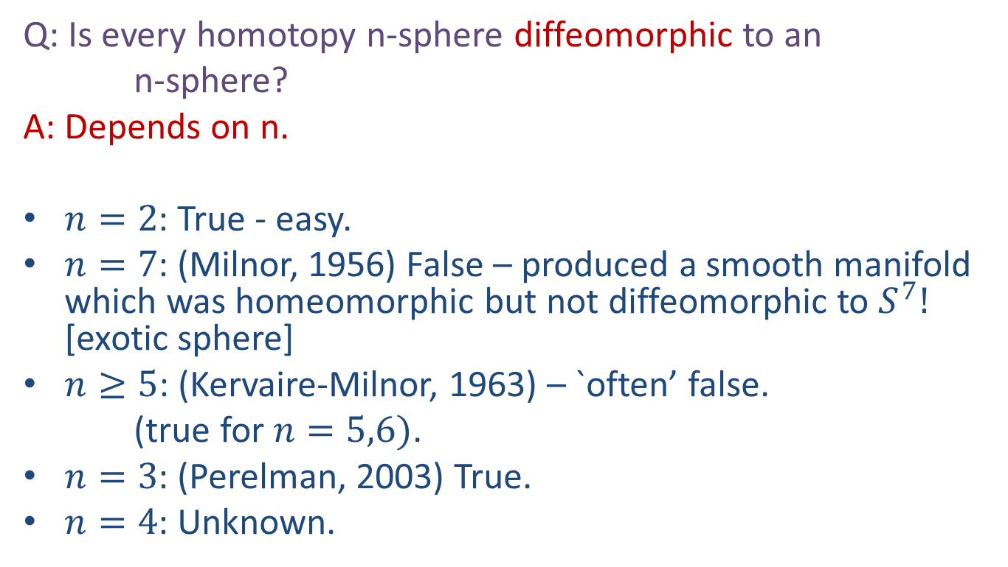
Smooth Poincaré Conjecture
Q: Is every homotopy n-sphere diffeomorphic to an
n-sphere?
A: Depends on n.
$n=2$: True - easy.
$n=7$: (Milnor, 1956) False – produced a smooth manifold which was homeomorphic but not diffeomorphic to $S^{7}!$ [exotic sphere]
$n≥5$: (Kervaire-Milnor, 1963) – `often’ false.
(true for $n=5,6)$.
$n=3$: (Perelman, 2003) True.
$n=4$: Unknown.

Slide 5
Smooth Poincaré Conjecture
Q: Is every homotopy n-sphere diffeomorphic to an
n-sphere?
A: Depends on n.
$n=2$: True - easy.
$n=7$: (Milnor, 1956) False – produced a smooth manifold which was homeomorphic but not diffeomorphic to $S^{7}!$ [exotic sphere]
$n≥5$: (Kervaire-Milnor, 1963) – `often’ false.
(true for $n=5,6)$.
$n=3$: (Perelman, 2003) True.
$n=4$: Unknown.

Slide 6
Main Question
For which n do there exist exotic n-spheres?

Slide 7
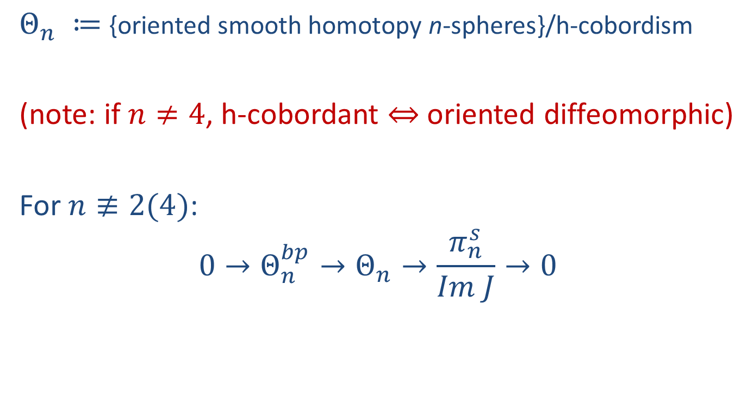
Kervaire-Milnor
$Θ_{n} ≔${oriented smooth homotopy n-spheres}/h-cobordism
(note: if $n≠4$, h-cobordant $⇔$oriented diffeomorphic)
For $n≢2(4)$:
$$0→Θ_{n}^{bp}→Θ_{n}→\frac{π_{n}^{s}}{Im J}→0$$

Slide 8
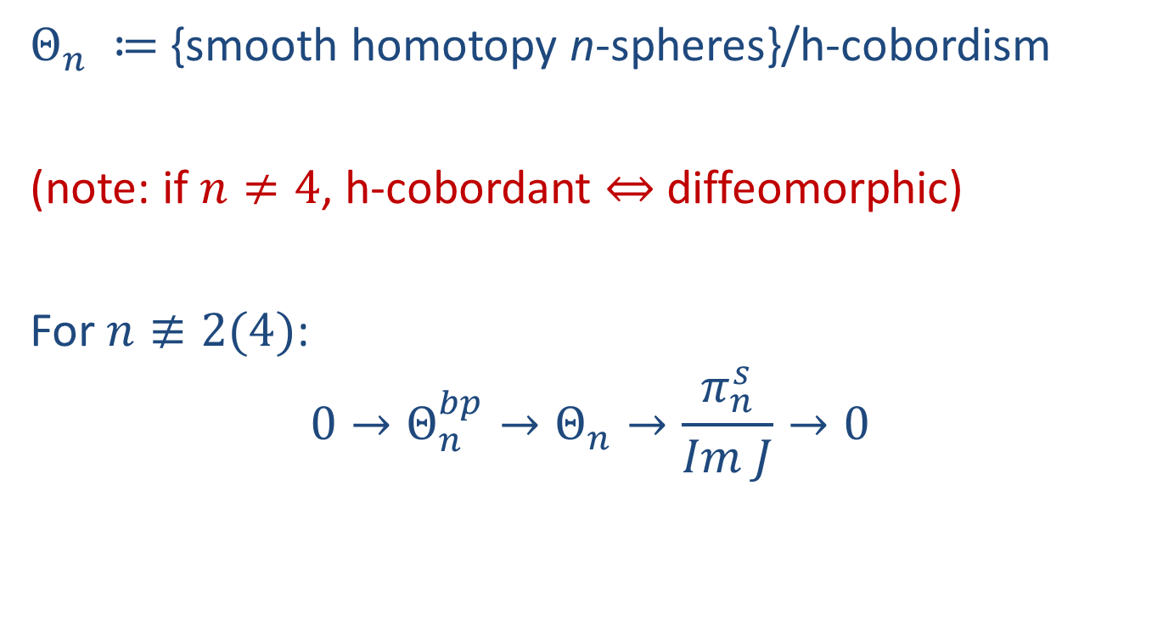
Kervaire-Milnor
$Θ_{n} ≔${smooth homotopy n-spheres}/h-cobordism
(note: if $n≠4$, h-cobordant $⇔$diffeomorphic)
For $n≢2(4)$:
$$0→Θ_{n}^{bp}→Θ_{n}→\frac{π_{n}^{s}}{Im J}→0$$

Slide 9
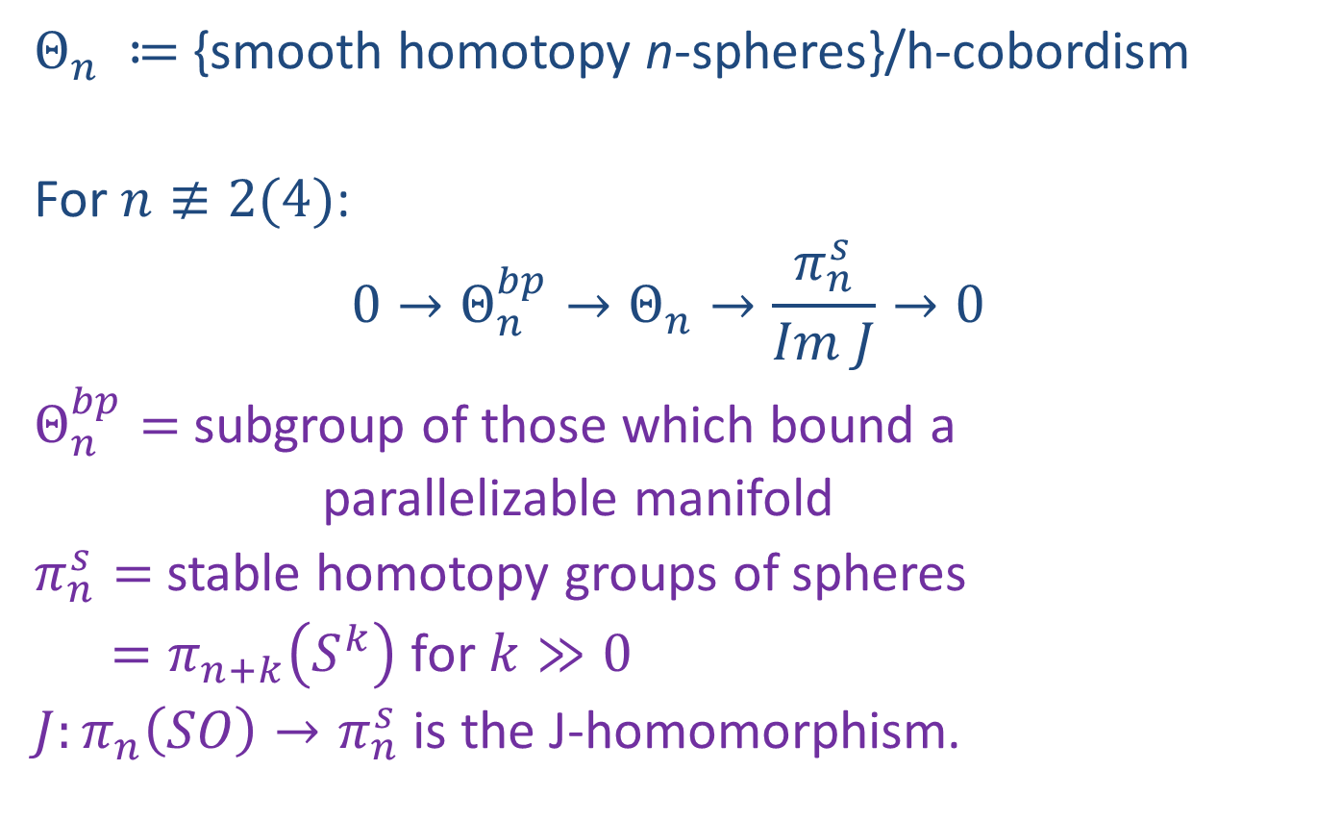
Kervaire-Milnor
$Θ_{n} ≔${smooth homotopy n-spheres}/h-cobordism
For $n≢2(4)$:
$$0→Θ_{n}^{bp}→Θ_{n}→\frac{π_{n}^{s}}{Im J}→0$$
$Θ_{n}^{bp}=$ subgroup of those which bound a
parallelizable manifold
$π_{n}^{s}=$ stable homotopy groups of spheres
$=π_{n+k}\left(S^{k}\right)$ for $k≫0$
$J:π_{n}\left(SO\right)→π_{n}^{s}$ is the J-homomorphism.

Slide 10
Kervaire-Milnor
$Θ_{n} ≔${smooth homotopy n-spheres}/h-cobordism
For $n≢2(4)$:
$$0→Θ_{n}^{bp}→Θ_{n}→\frac{π_{n}^{s}}{Im J}→0$$
$Θ_{n}^{bp}=$ subgroup of those which bound a
parallelizable manifold
$π_{n}^{s}=$ stable homotopy groups of spheres
$=π_{n+k}\left(S^{k}\right)$ for $k≫0$
$J:π_{n}\left(SO\right)→π_{n}^{s}$ is the J-homomorphism.

Slide 11
Kervaire-Milnor
$Θ_{n} ≔${smooth homotopy n-spheres}/h-cobordism
For $n≢2(4)$:
$$0→Θ_{n}^{bp}→Θ_{n}→\frac{π_{n}^{s}}{Im J}→0$$
$Θ_{n}^{bp}=$ subgroup of those which bound a
parallelizable manifold
$π_{n}^{s}=$ stable homotopy groups of spheres
$=π_{n+k}\left(S^{k}\right)$ for $k≫0$
$J:π_{n}\left(SO\right)→π_{n}^{s}$ is the J-homomorphism.

Slide 12
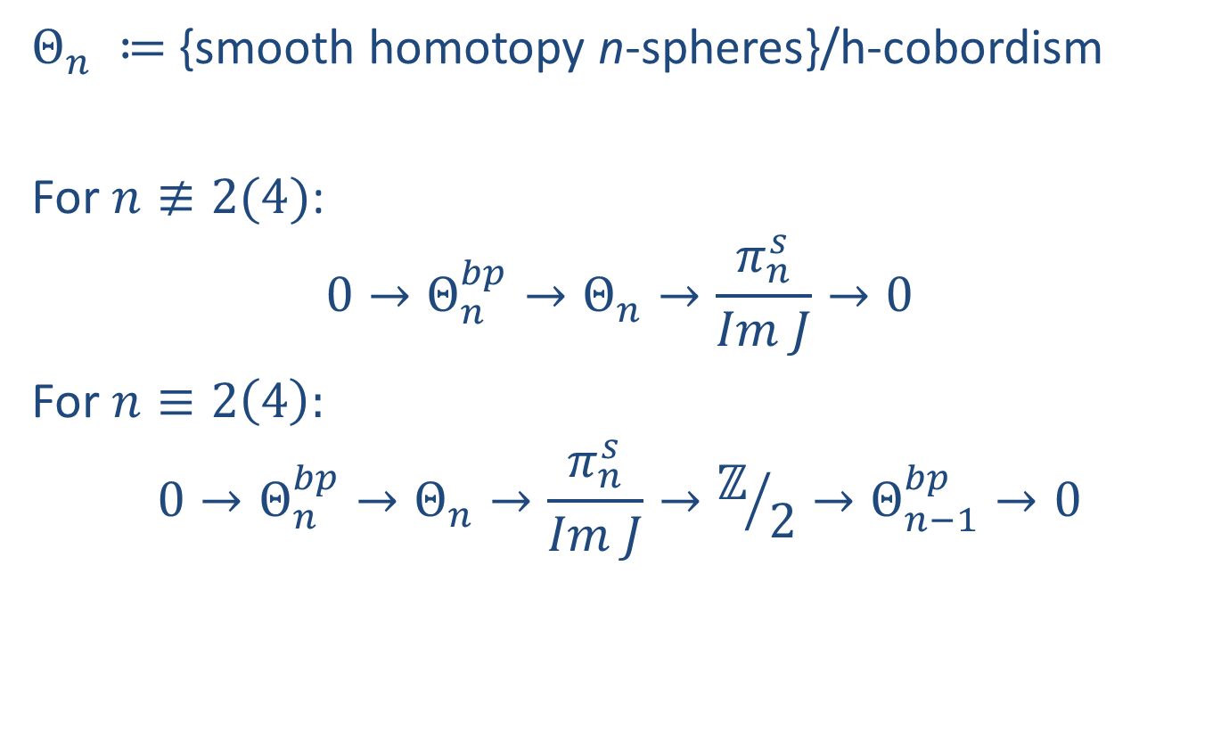
Kervaire-Milnor
$Θ_{n} ≔${smooth homotopy n-spheres}/h-cobordism
For $n≢2(4)$:
$$0→Θ_{n}^{bp}→Θ_{n}→\frac{π_{n}^{s}}{Im J}→0$$
For $n≡2\left(4\right):$
$$0→Θ_{n}^{bp}→Θ_{n}→\frac{π_{n}^{s}}{Im J}→ℤ/2→Θ_{n−1}^{bp}→0$$

Slide 13

$$Θ_{n}^{bp}$$
Trivial for n even
Cyclic for n odd

Slide 14
$$Θ_{n}^{bp}$$
Trivial for n even
Cyclic for n odd
  Generated by boundary of an explicit parallelizable manifold given by plumbing construction

Slide 15
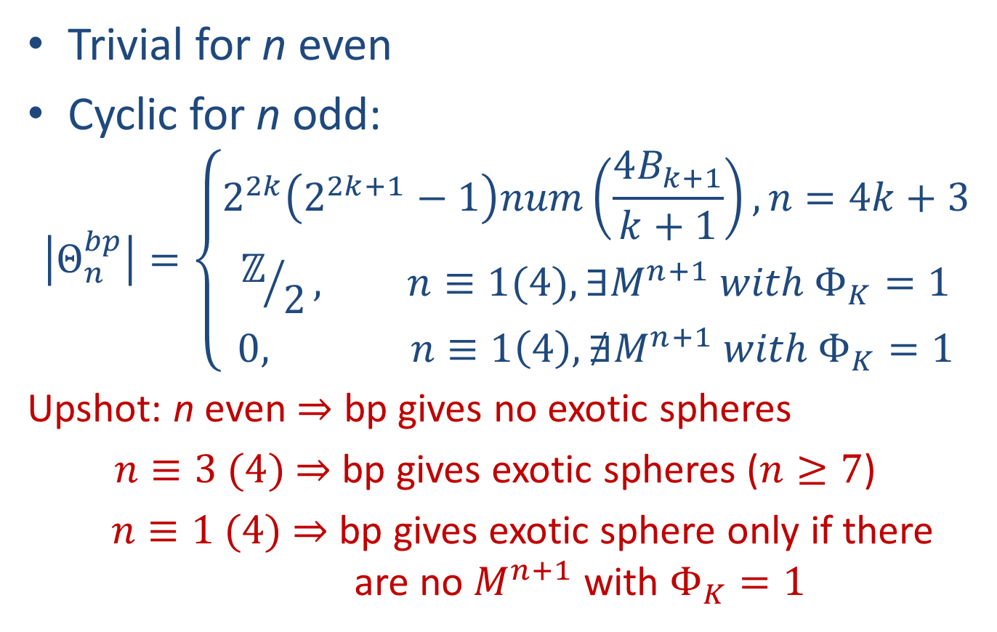
$$Θ_{n}^{bp}$$
Trivial for n even
Cyclic for n odd:
$$\left|Θ_{n}^{bp}\right|=\left\{\begin{matrix}2^{2k}\left(2^{2k+1}−1\right)num\left(\frac{4B_{k+1}}{k+1}\right), n=4k+3 \\ ℤ/2, n≡1(4), ∃M^{n+1} with Φ_{K}=1 \\ 0, n≡1\left(4\right), ∄M^{n+1} with Φ_{K}=1\end{matrix}\right.$$
Upshot: n even $⇒$ bp gives no exotic spheres
$n≡3 (4)$ $⇒$ bp gives exotic spheres ($n≥7$)
$n≡1 (4)$ $⇒$ bp gives exotic sphere only if there are no $M^{n+1}$ with $Φ_{K}=1$

Slide 16
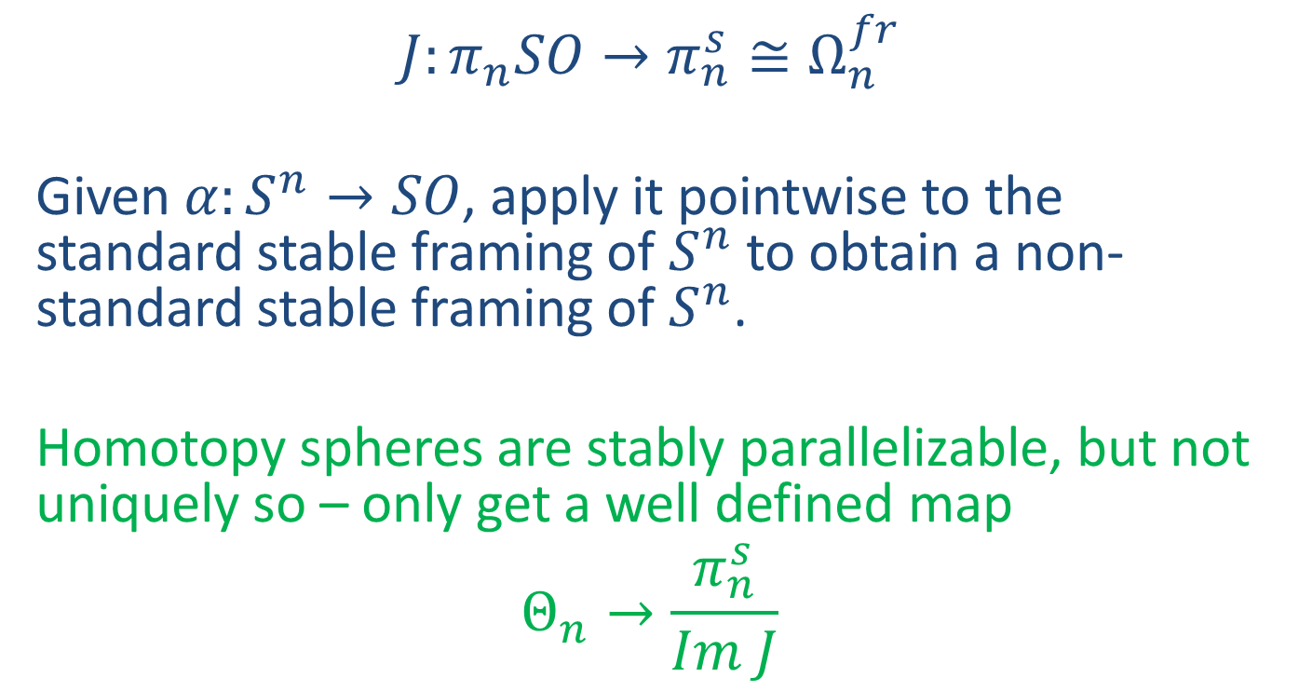
J-homomorphism
$$J:π_{n}SO→π_{n}^{s}≅Ω_{n}^{fr}$$
Given $α:S^{n}→SO$, apply it pointwise to the standard stable framing of $S^{n}$ to obtain a non-standard stable framing of $S^{n}$.
Homotopy spheres are stably parallelizable, but not uniquely so – only get a well defined map
$$Θ_{n}→\frac{π_{n}^{s}}{Im J}$$

Slide 17

J-homomorphism
$$J:π_{n}SO→π_{n}^{s}≅Ω_{n}^{fr}$$

Slide 18
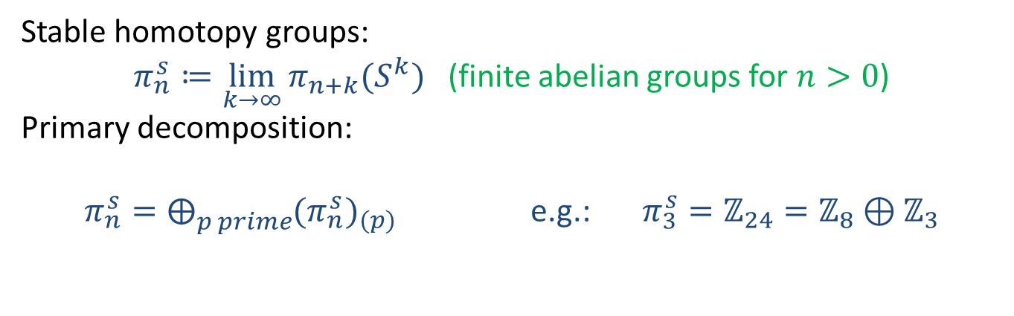

$$π_{∗}^{s}$$
Stable homotopy groups:
$π_{n}^{s}≔\lim_{k→∞}{π_{n+k}(S^{k})}$ (finite abelian groups for $n>0$)
Primary decomposition:
$π_{n}^{s}=⨁_{p prime}{{(π_{n}^{s})}_{(p)}}$ e.g.: $π_{3}^{s}=ℤ_{24}=ℤ_{8}⊕ℤ_{3}$

Slide 19
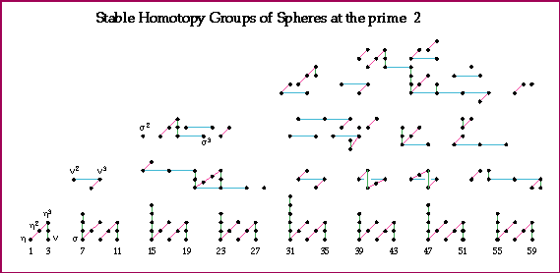
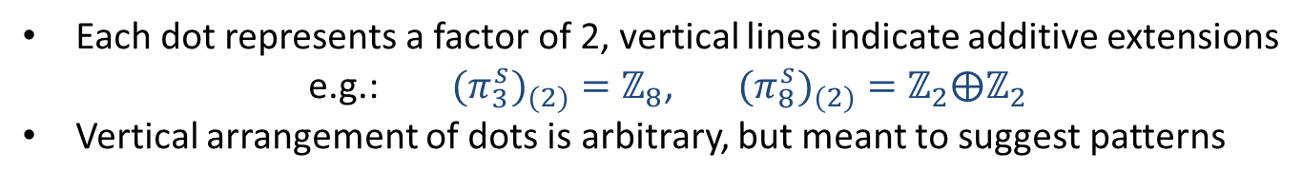
Computation: Mahowald-Tangora-Kochman
Picture: A. Hatcher
Each dot represents a factor of 2, vertical lines indicate additive extensions
e.g.: ${{(π}_{3}^{s})}_{(2)}=ℤ_{8}$, ${{(π}_{8}^{s})}_{(2)}=ℤ_{2}⨁ℤ_{2}$
Vertical arrangement of dots is arbitrary, but meant to suggest patterns

Slide 20
Each dot represents a factor of 2, vertical lines indicate additive extensions
e.g.: ${{(π}_{3}^{s})}_{(2)}=ℤ_{8}$, ${{(π}_{8}^{s})}_{(2)}=ℤ_{2}⨁ℤ_{2}$
Vertical arrangement of dots is arbitrary, but meant to suggest patterns

Slide 21
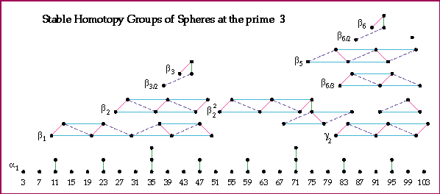
Computation: Nakamura -Tangora
Picture: A. Hatcher

Slide 22
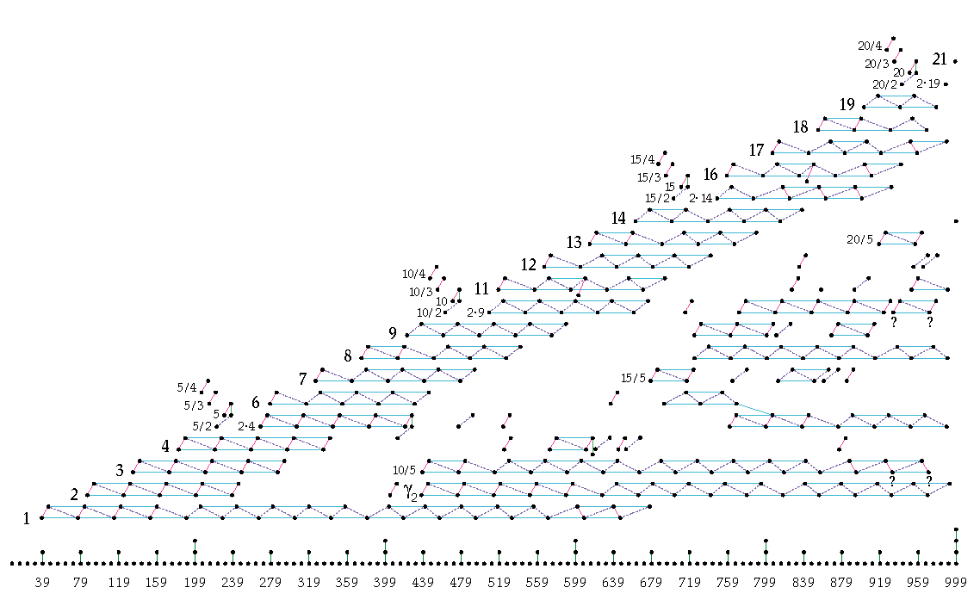
(π_{n}^{s})₍₅₎
Computation: D. Ravenel
Picture: A. Hatcher
n

Slide 23
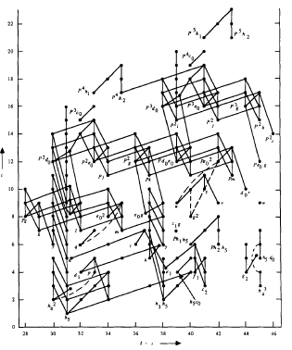
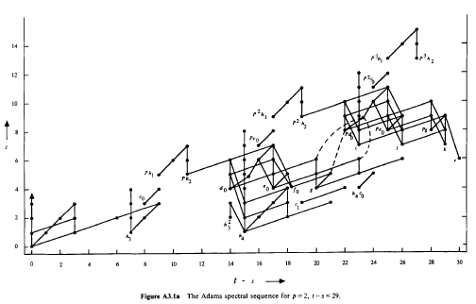

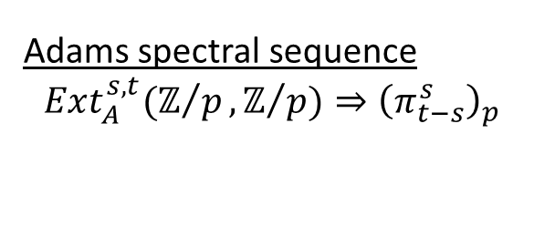
Adams spectral sequence
$$Ext_{A}^{s,t}(ℤ/p,ℤ/{p)⇒{\left(π_{t−s}^{s}\right)}_{p}}$$
$$π_{t−s}^{s}$$

Slide 24
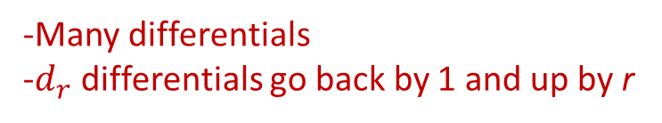
Adams spectral sequence
$$Ext_{A}^{s,t}(ℤ/p,ℤ/{p)⇒{\left(π_{t−s}^{s}\right)}_{p}}$$
$$π_{t−s}^{s}$$
-Many differentials
-$d_{r}$ differentials go back by 1 and up by r

Slide 25
Adams spectral sequence
$$Ext_{A}^{s,t}(ℤ/p,ℤ/{p)⇒{\left(π_{t−s}^{s}\right)}_{p}}$$
$$π_{t−s}^{s}$$

Slide 26
Adams spectral sequence
$$Ext_{A}^{s,t}(ℤ/p,ℤ/{p)⇒{\left(π_{t−s}^{s}\right)}_{p}}$$
$$π_{t−s}^{s}$$

Slide 27

Kervaire Invariant
$$Φ_{K}:π_{n}^{s}→ℤ/2$$
Browder:
$${(Φ}_{K}≠0)⇒\left(n=2^{k}−2\right)$$

Slide 28

Kervaire Invariant
$$Φ_{K}:π_{n}^{s}→ℤ/2$$
Browder:
$${(Φ}_{K}\left(x\right)≠0)⇔\left({x detected by h_{j}^{2}}_{ }in ASS\right)$$

Slide 29
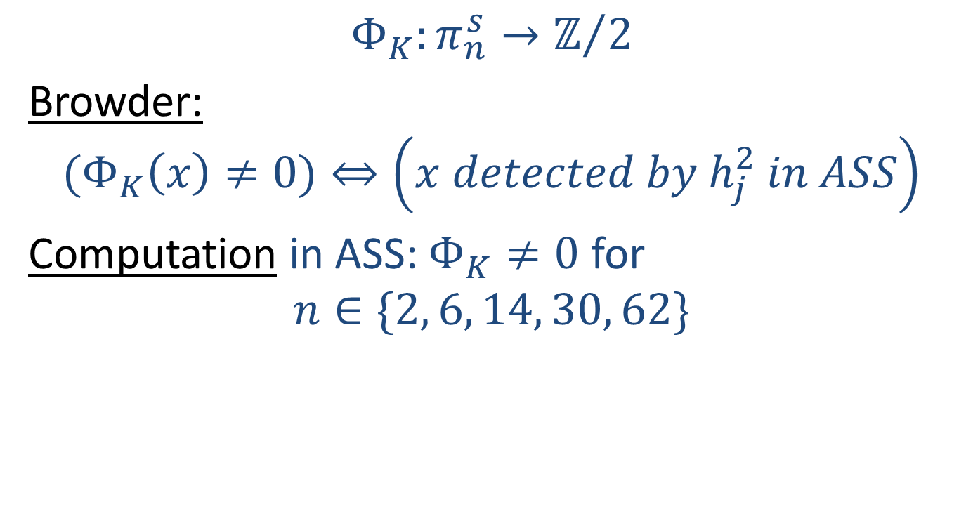
Kervaire Invariant
$$Φ_{K}:π_{n}^{s}→ℤ/2$$
Browder:
$${(Φ}_{K}\left(x\right)≠0)⇔\left({x detected by h_{j}^{2}}_{ }in ASS\right)$$
Computation in ASS: $Φ_{K}≠0$ for
$$n∈\{2, 6, 14, 30, 62\}$$

Slide 30
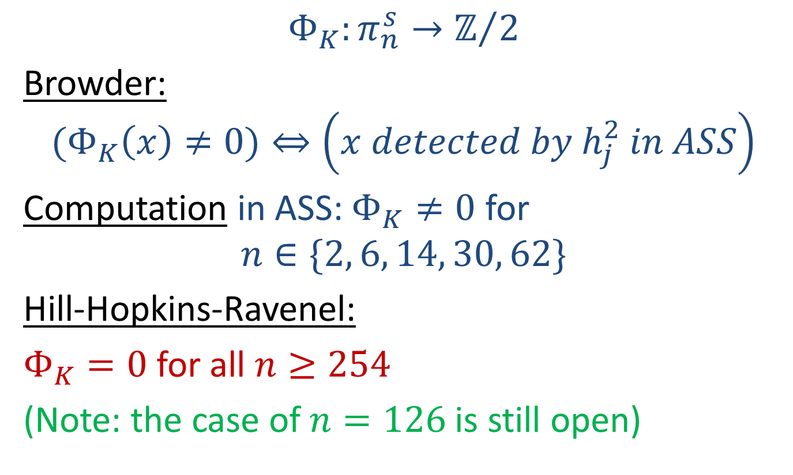
Kervaire Invariant
$$Φ_{K}:π_{n}^{s}→ℤ/2$$
Browder:
$${(Φ}_{K}\left(x\right)≠0)⇔\left({x detected by h_{j}^{2}}_{ }in ASS\right)$$
Computation in ASS: $Φ_{K}≠0$ for
$$n∈\{2, 6, 14, 30, 62\}$$
Hill-Hopkins-Ravenel:
$Φ_{K}=0$ for all $n≥254$
(Note: the case of $n=126$ is still open)

Slide 31
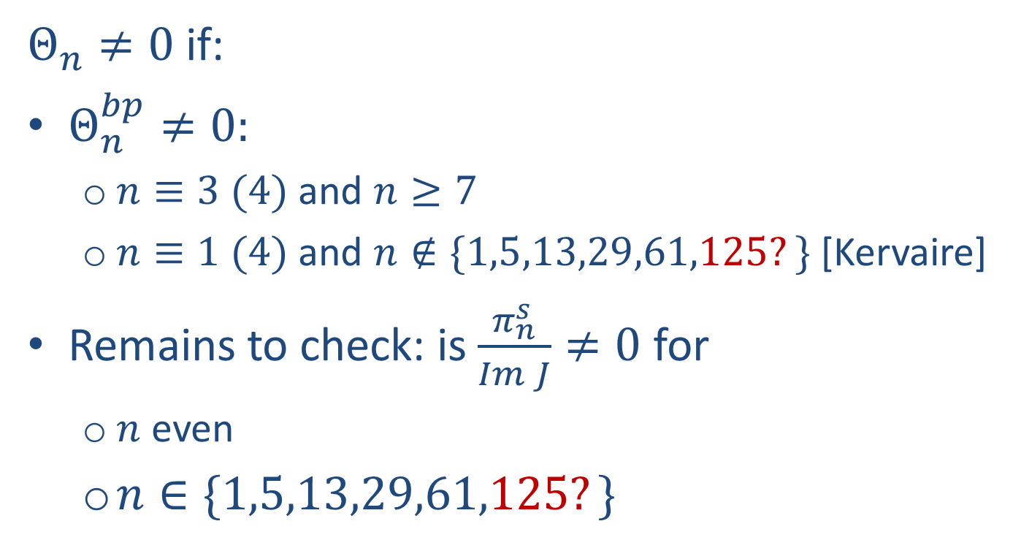
Summary: Exotic spheres
$Θ_{n}≠0$ if:
$Θ_{n}^{bp}≠0:$
  $n≡3 (4)$ and $n≥7$
  $n≡1 (4)$ and $n∉\{1,5,13,29,61,125?\}$ [Kervaire]
Remains to check: is $\frac{π_{n}^{s}}{Im J}≠0$ for
  $n$ even
  $n∈\{1,5,13,29,61,125?\}$

Slide 33
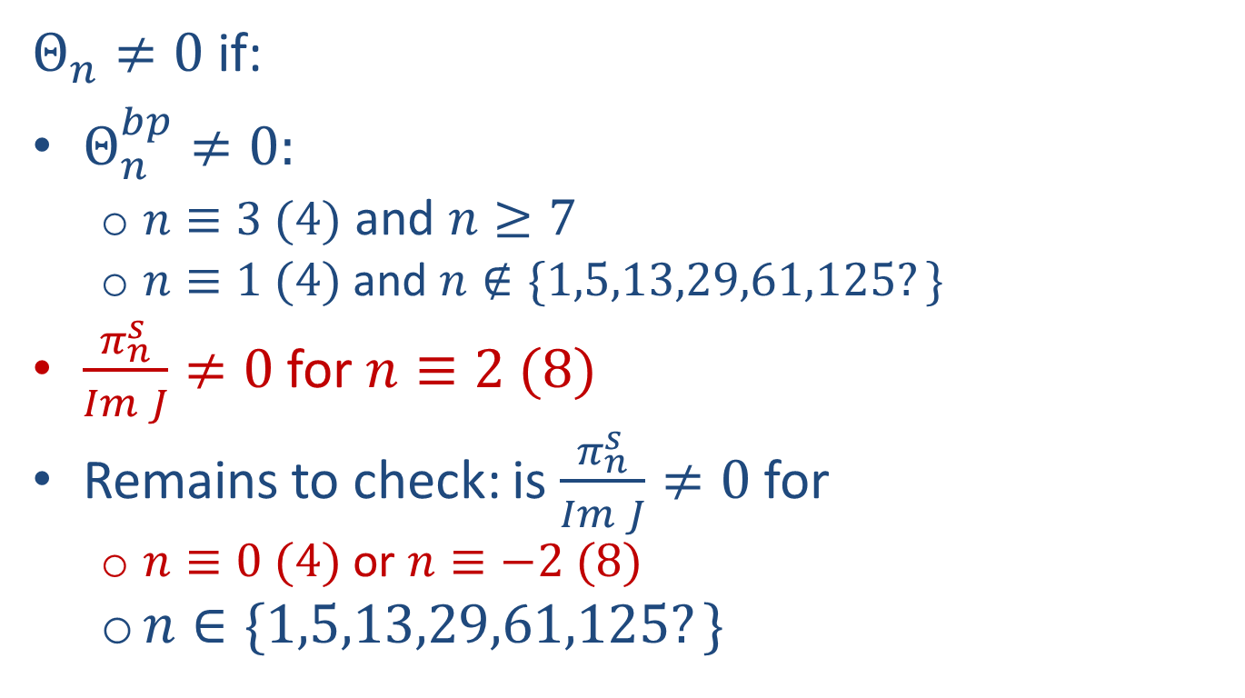
Summary: Exotic spheres
$Θ_{n}≠0$ if:
$Θ_{n}^{bp}≠0:$
  $n≡3 (4)$ and $n≥7$
  $n≡1 (4)$ and $n∉\{1,5,13,29,61,125?\}$
$\frac{π_{n}^{s}}{Im J}≠0$ for $n≡2 (8)$
Remains to check: is $\frac{π_{n}^{s}}{Im J}≠0$ for
  $n≡0 (4)$ or $n≡−2 (8)$
  $n∈\{1,5,13,29,61,125?\}$

Slide 34

Low dimensional computations
Limitation: only know ${\left(π_{n}^{s}\right)}_{2}$ for $n≤63$
${\left(\frac{π_{n}^{s}}{Im J}\right)}_{p}=0$ in this range for $p≥7.$

Slide 35
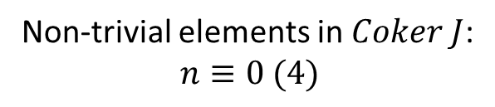
Low dimensional computations
Non-trivial elements in $Coker J$:
$$n≡0 (4)$$

Slide 36
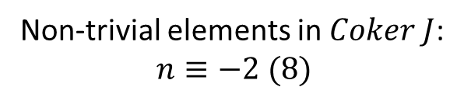
Low dimensional computations
Non-trivial elements in $Coker J$:
$$n≡−2 (8)$$

Slide 37
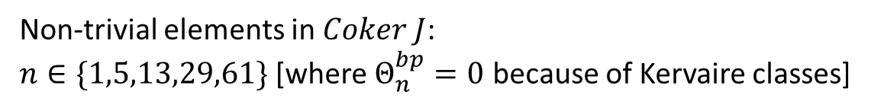
Low dimensional computations
Non-trivial elements in $Coker J$:
$n∈\{1,5,13,29,61\}$ [where $Θ_{n}^{bp}=0$ because of Kervaire classes]

Slide 38

Low dimensional computations
Conclusion
For $n≤63$, the only $n$ for which $Θ_{n}=0$ are:
$$1,2,3,4,5,6,12,61$$

Slide 39

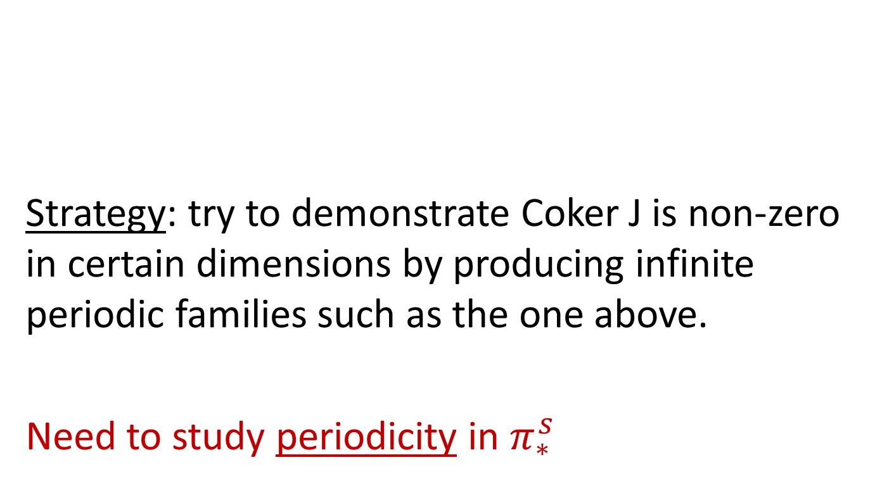
Beyond low dimensions…
Strategy: try to demonstrate Coker J is non-zero in certain dimensions by producing infinite periodic families such as the one above.
Need to study periodicity in $π_{∗}^{s}$

Slide 40

Periodicity in $π_{∗}^{s}$

Slide 41
Periodicity in $π_{∗}^{s}$

Slide 42
Periodicity in $π_{∗}^{s}$

Slide 43
Periodicity in $π_{∗}^{s}$

Slide 44
Periodicity in $π_{∗}^{s}$

Slide 45
Periodicity in $π_{∗}^{s}$

Slide 46
Periodicity in $π_{∗}^{s}$

Slide 47
Periodicity in $π_{∗}^{s}$

Slide 48
Periodicity in $π_{∗}^{s}$

Slide 49
Periodicity in $π_{∗}^{s}$

Slide 50
Periodicity in $π_{∗}^{s}$

Slide 51
Periodicity in $π_{∗}^{s}$

Slide 52
Periodicity in $π_{∗}^{s}$

Slide 53
Periodicity in $π_{∗}^{s}$

Slide 54
Periodicity in $π_{∗}^{s}$

Slide 55
Periodicity in $π_{∗}^{s}$

Slide 56
Periodicity in $π_{∗}^{s}$

Slide 57
v₁ - periodic layer
consists solely of α-family
(π_{n}^{s})₍₅₎
period = 2(p-1) = 8

Slide 58
v₁ - periodic layer
consists solely of α-family
(π_{n}^{s})₍₅₎
period = 2(p-1) = 8

Slide 59


Greek letter notation: the $α$-family

Slide 60
v₂ - periodic layer
= β−family
(π_{n}^{s})₍₅₎
period = 2(p² - 1) = 48

Slide 61
(π_{n}^{s})₍₅₎

Slide 62
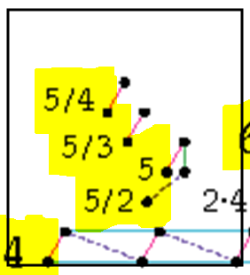

$v_{1}$-torsion in the $v_{2}$-family

Slide 63
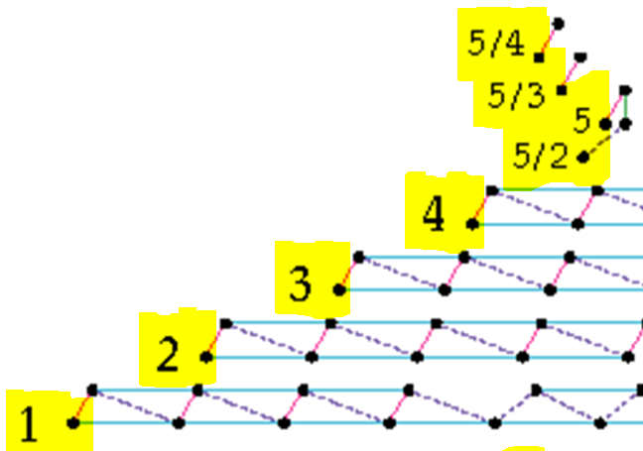
Greek Letter Names (Miller-Ravenel-Wilson)

Slide 64
v₃ - periodic layer
= γ−family
(π_{n}^{s})₍₅₎
period = 2(p³ - 1) = 248

Slide 65
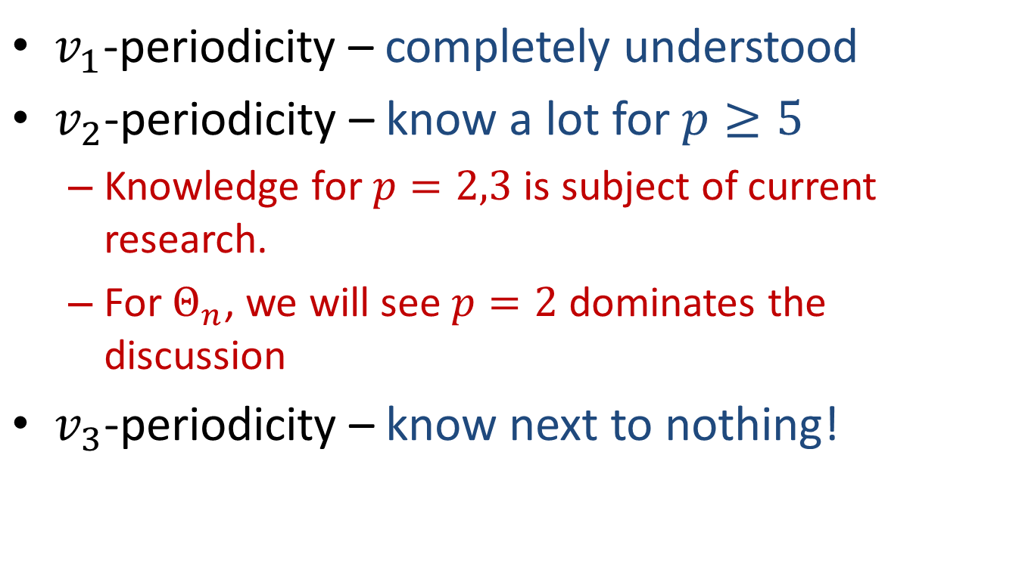
$v_{1}$-periodicity – completely understood
$v_{2}$-periodicity – know a lot for $p≥5$
  Knowledge for $p=2,3$ is subject of current research.
  For $Θ_{n}$, we will see $p=2$ dominates the discussion
$v_{3}$-periodicity – know next to nothing!

Slide 67


Exotic spheres from $β$-family
$β_{k}=β_{k/1,1}$ exists for $p≥5$ and $k≥1$ [Smith-Toda]
  $Θ_{n}≠0$ for $n≡−2\left(p−1\right)−2 mod 2(p^{2}−1)$

Slide 69
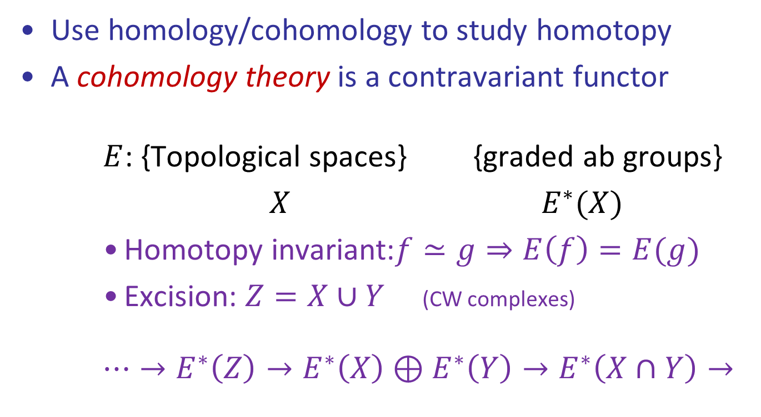
Cohomology theories
Use homology/cohomology to study homotopy
A cohomology theory is a contravariant functor
    $E$: {Topological spaces} {graded ab groups}
    $X$ $E^{∗}(X)$
    Homotopy invariant:$f≃g⇒E\left(f\right)=E(g)$
    Excision: $Z=X∪Y$ (CW complexes)
    $$⋯→E^{∗}\left(Z\right)→E^{∗}\left(X\right)⊕E^{∗}\left(Y\right)→E^{∗}\left(X∩Y\right)→$$

Slide 70
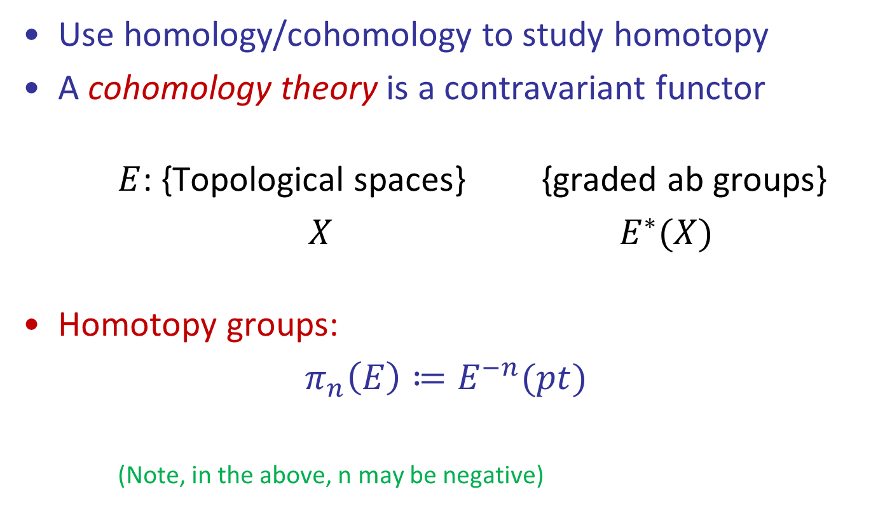
Cohomology theories
Use homology/cohomology to study homotopy
A cohomology theory is a contravariant functor
    $E$: {Topological spaces} {graded ab groups}
    $X$ $E^{∗}(X)$
Homotopy groups:
$π_{n}\left(E\right)≔E^{−n}(pt)$
(Note, in the above, n may be negative)

Slide 71
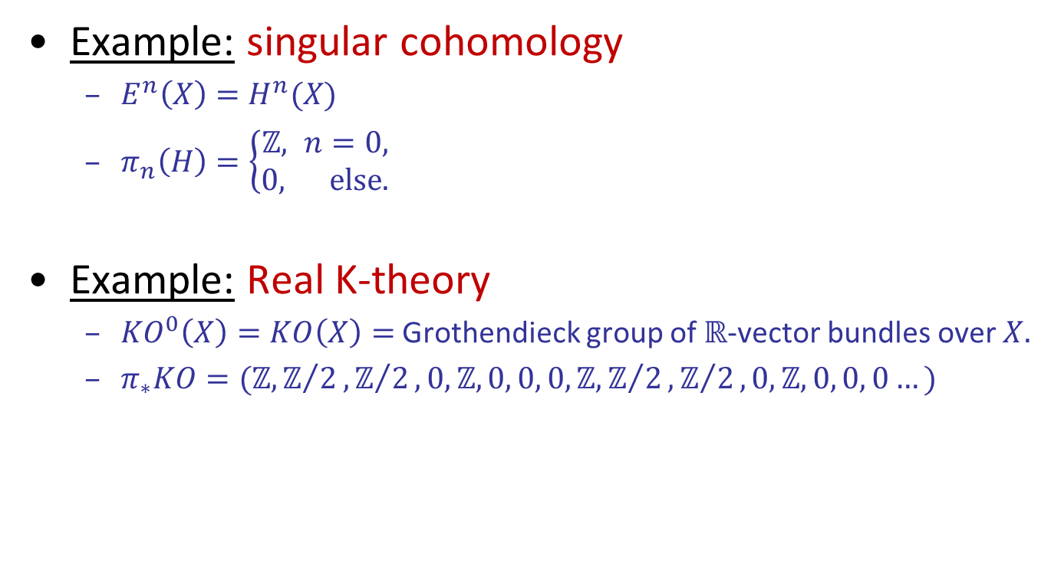
Cohomology theories
Example: singular cohomology
  $E^{n}\left(X\right)=H^{n}(X)$
  $π_{n}\left(H\right)=\left\{\begin{aligned}ℤ, n=0, \\ 0, \text{else}\text{.}\end{aligned}\right.$
Example: Real K-theory
  ${KO}^{0}\left(X\right)=KO\left(X\right)=$ Grothendieck group of $ℝ$-vector bundles over $X.$
  $π_{∗}KO=(ℤ,ℤ/2,ℤ/2, 0, ℤ, 0, 0, 0, ℤ,ℤ/2,ℤ/2, 0, ℤ, 0, 0, 0…)$

Slide 72
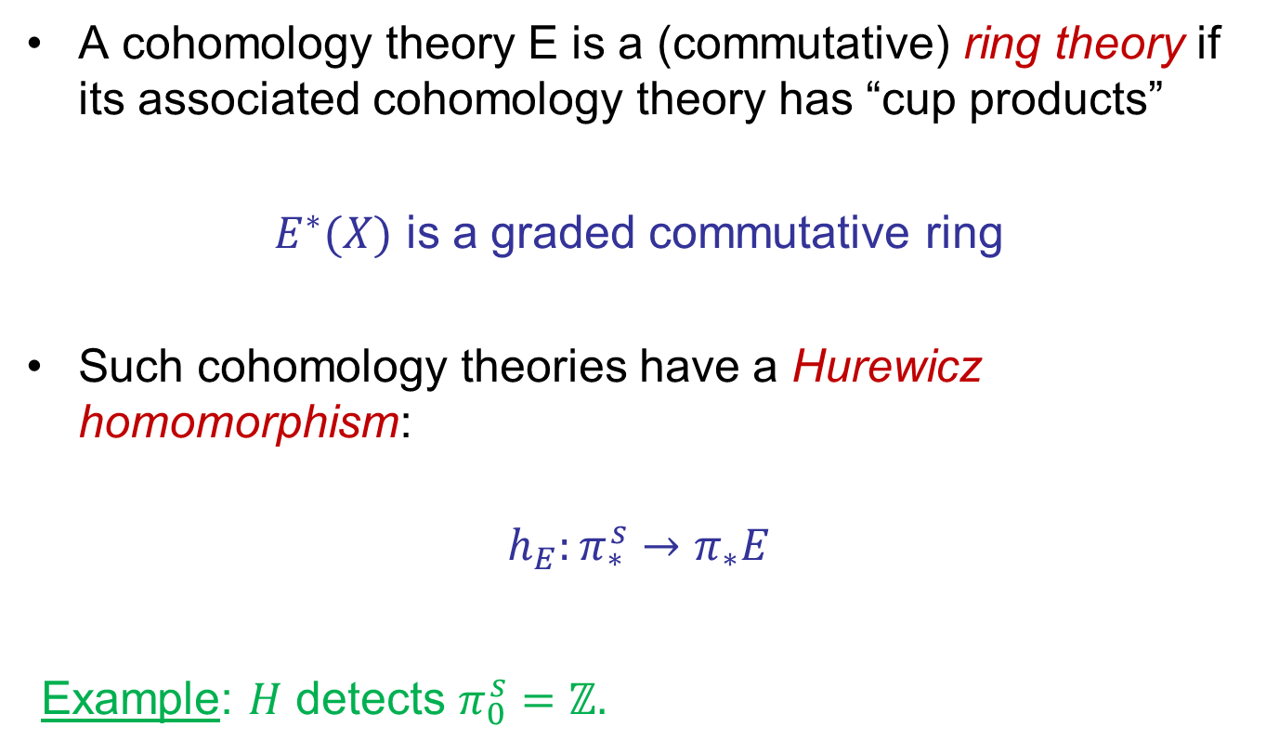
Hurewicz Homomorphism
A cohomology theory E is a (commutative) ring theory if its associated cohomology theory has “cup products”
$E^{∗}(X)$ is a graded commutative ring
Such cohomology theories have a Hurewicz homomorphism:
$$h_{E}:π_{∗}^{s}→π_{∗}E$$
Example: $H$ detects $π_{0}^{s}=ℤ.$

Slide 73
Example: KO (real K-theory)

Slide 74
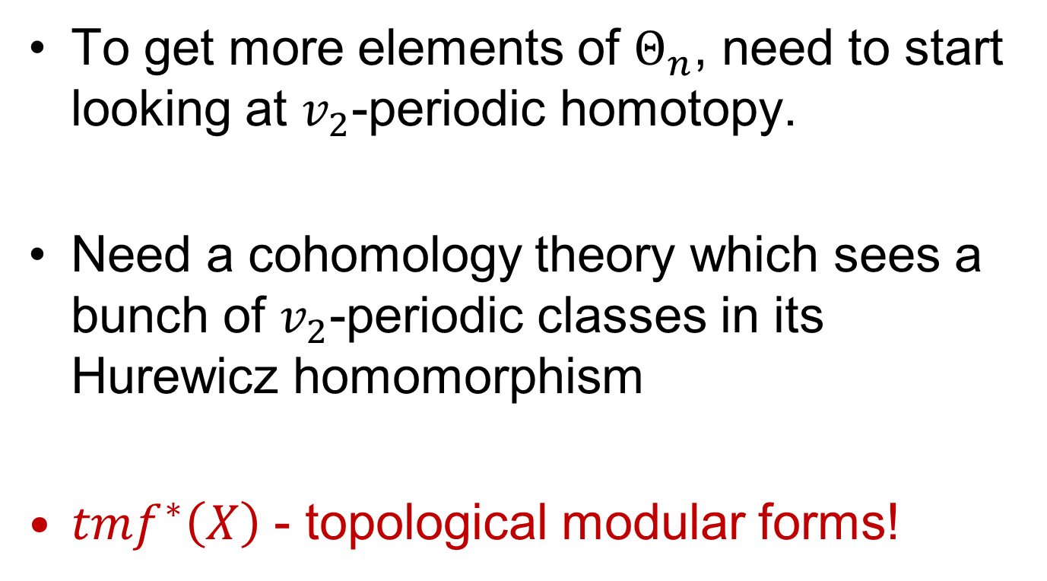
To get more elements of $Θ_{n}$, need to start looking at $v_{2}$-periodic homotopy.
Need a cohomology theory which sees a bunch of $v_{2}$-periodic classes in its Hurewicz homomorphism
${tmf}^{∗}\left(X\right)$ - topological modular forms!

Slide 75
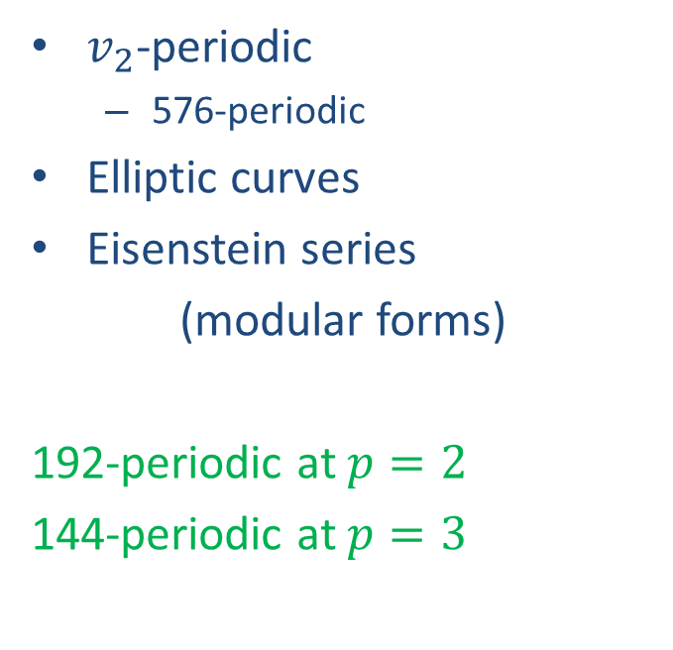

Topological Modular Forms
KO
TMF
$v_{1}$-periodic
  8-periodic
Multiplicative group
Bernoulli numbers
$v_{2}$-periodic
  576-periodic
Elliptic curves
Eisenstein series
(modular forms)
192-periodic at $p=2$
144-periodic at $p=3$

Slide 76
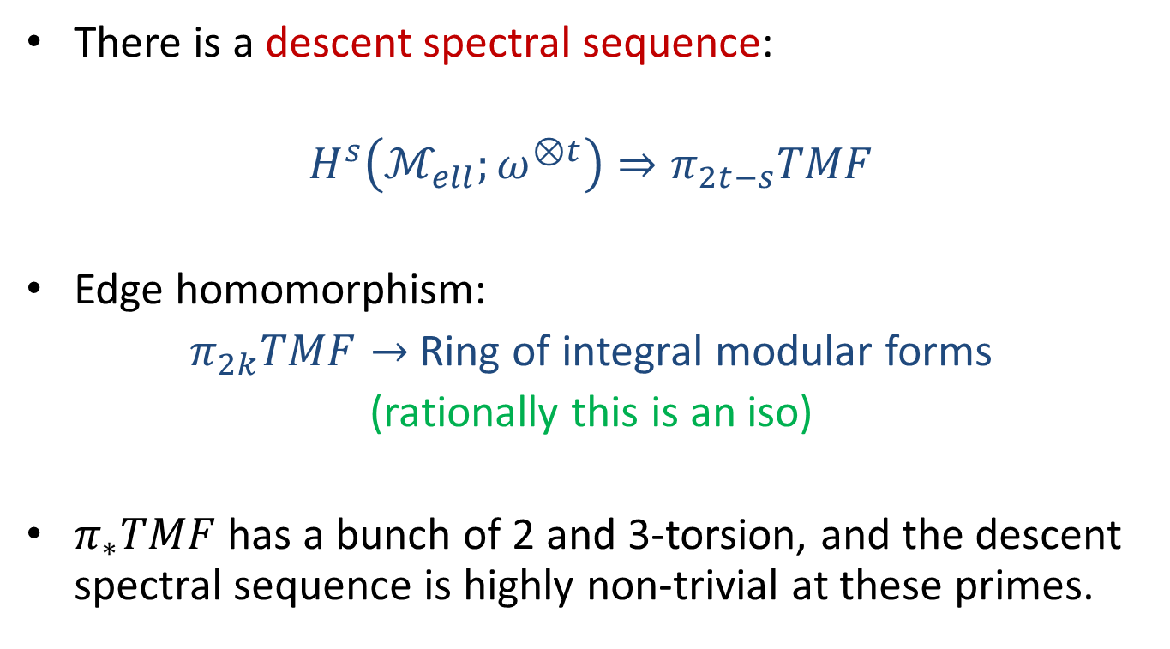
Topological Modular Forms
There is a descent spectral sequence:
$$H^{s}\left(ℳ_{ell};ω^{⊗t}\right)⇒π_{2t−s}TMF$$
Edge homomorphism:
$π_{2k}TMF→$ Ring of integral modular forms
(rationally this is an iso)
$π_{∗}TMF$ has a bunch of 2 and 3-torsion, and the descent spectral sequence is highly non-trivial at these primes.

Slide 77
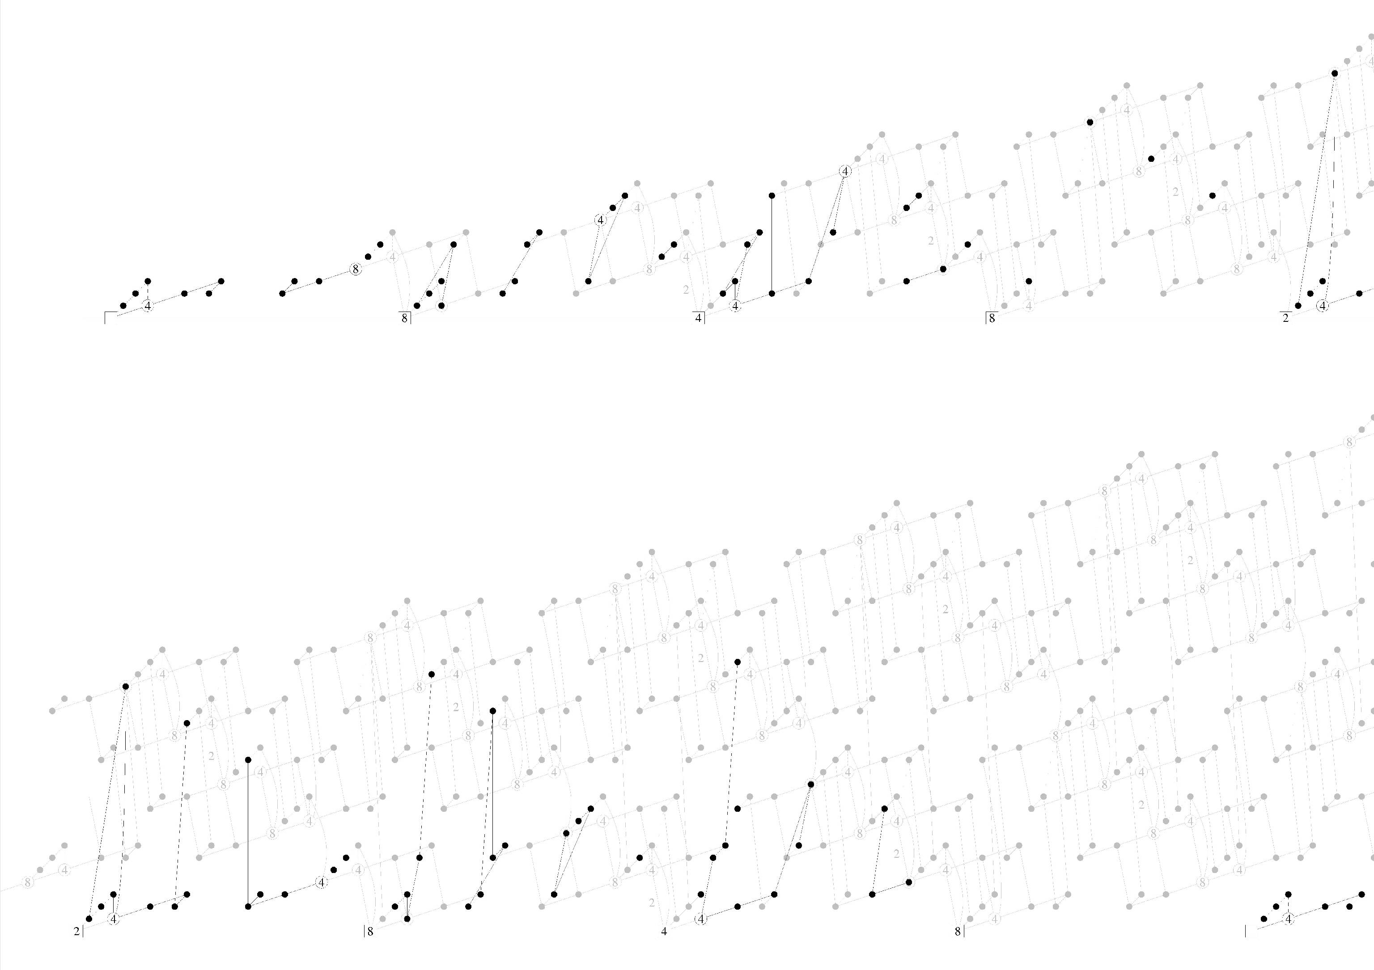

The decent spectral sequence for TMF
(p=2)
$$H^{s}\left(ℳ_{ell};ω^{⊗t}\right)⇒π_{2t−s}TMF$$

Slide 78
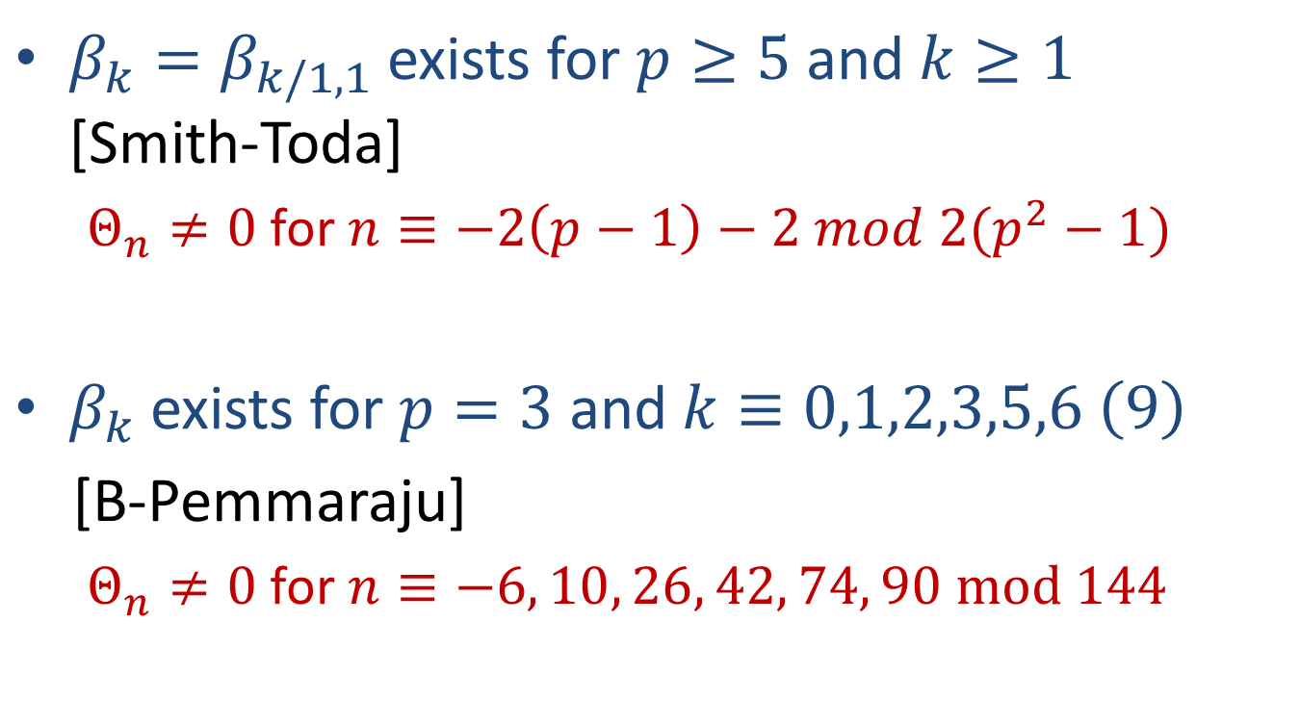
Exotic spheres from $β$-family
$β_{k}=β_{k/1,1}$ exists for $p≥5$ and $k≥1$ [Smith-Toda]
  $Θ_{n}≠0$ for $n≡−2\left(p−1\right)−2 mod 2(p^{2}−1)$
$β_{k}$ exists for $p=3$ and $k≡0,1,2,3,5,6 \left(9\right)$
[B-Pemmaraju]
  $Θ_{n}≠0$ for $n≡−6, 10, 26, 42, 74, 90 mod 144$

Slide 79
Exotic spheres from $β$-family
$β_{k}=β_{k/1,1}$ exists for $p≥5$ and $k≥1$ [Smith-Toda]
  $Θ_{n}≠0$ for $n≡−2\left(p−1\right)−2 mod 2(p^{2}−1)$
$β_{k}$ exists for $p=3$ and $k≡0,1,2,3,5,6 \left(9\right)$
[B-Pemmaraju]
  $Θ_{n}≠0$ for $n≡−6, 10, 26, 42, 74, 90 mod 144$

Slide 80
Hurewicz image of TMF (p = 3)

Slide 82
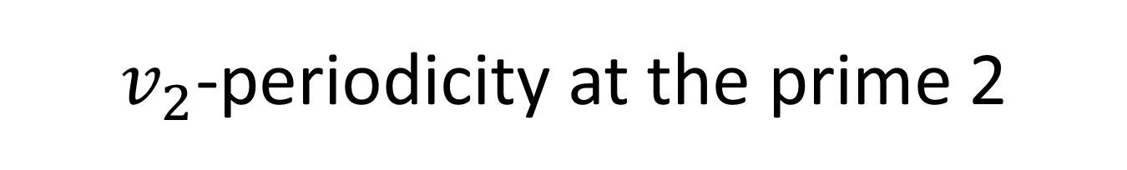
$v_{2}$-periodicity at the prime 2

Slide 83
$v_{2}$-periodicity at the prime 2

Slide 84
The decent spectral sequence for TMF
(p=2)
Thm: (B-Mahowald)
The complete Hurewicz image:

Slide 85
Hurewicz image of TMF (p = 2)

