Slide 1
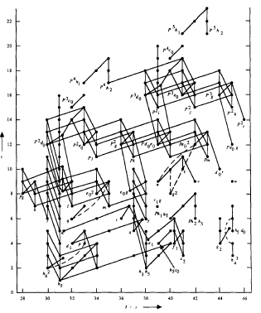
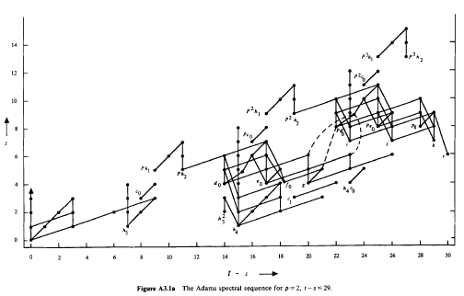

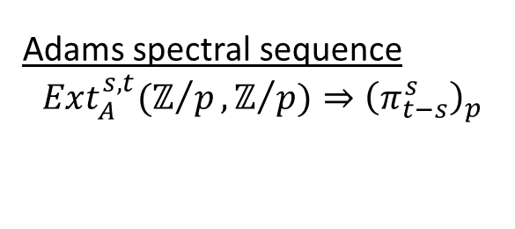
Adams spectral sequence
$$Ext_{A}^{s,t}(ℤ/p,ℤ/{p)⇒{\left(π_{t−s}^{s}\right)}_{p}}$$
$$π_{t−s}^{s}$$

Slide 2
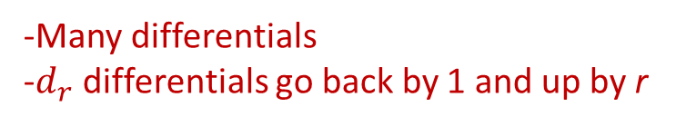
Adams spectral sequence
$$Ext_{A}^{s,t}(ℤ/p,ℤ/{p)⇒{\left(π_{t−s}^{s}\right)}_{p}}$$
$$π_{t−s}^{s}$$
-Many differentials
-$d_{r}$ differentials go back by 1 and up by r

Slide 3

Adams spectral sequence
$$Ext_{A}^{s,t}(ℤ/p,ℤ/{p)⇒{\left(π_{t−s}^{s}\right)}_{p}}$$
$$π_{t−s}^{s}$$
-Many differentials
-$d_{r}$ differentials go back by 1 and up by r
Notes:
HI(x) = 1 ⬄ x detected by h_i
D2(h_i)

Slide 4
Adams spectral sequence
$$Ext_{A}^{s,t}(ℤ/p,ℤ/{p)⇒{\left(π_{t−s}^{s}\right)}_{p}}$$
$$π_{t−s}^{s}$$

Slide 5
Adams spectral sequence
$$Ext_{A}^{s,t}(ℤ/p,ℤ/{p)⇒{\left(π_{t−s}^{s}\right)}_{p}}$$
$$π_{t−s}^{s}$$
Notes:
Kervaire Invariant
Browder ‘69
Barratt-Jones-Mahowald ’85
HHR ’09
Q: h_6^2 PC?
Q: d_r(h_i^2)?

Slide 6
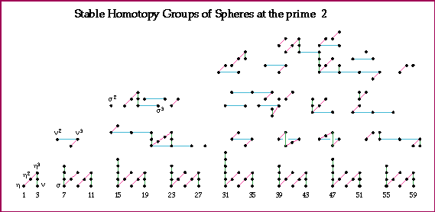
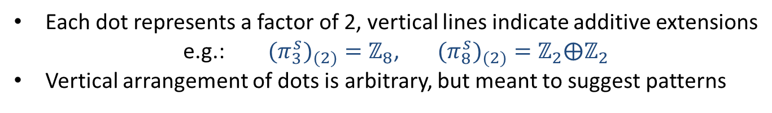
Computation: Mahowald-Tangora-Kochman
Picture: A. Hatcher
Each dot represents a factor of 2, vertical lines indicate additive extensions
e.g.: ${{(π}_{3}^{s})}_{(2)}=ℤ_{8}$, ${{(π}_{8}^{s})}_{(2)}=ℤ_{2}⨁ℤ_{2}$
Vertical arrangement of dots is arbitrary, but meant to suggest patterns

Slide 7
Each dot represents a factor of 2, vertical lines indicate additive extensions
e.g.: ${{(π}_{3}^{s})}_{(2)}=ℤ_{8}$, ${{(π}_{8}^{s})}_{(2)}=ℤ_{2}⨁ℤ_{2}$
Vertical arrangement of dots is arbitrary, but meant to suggest patterns
Notes:
J homo
Adams ‘66

Slide 8

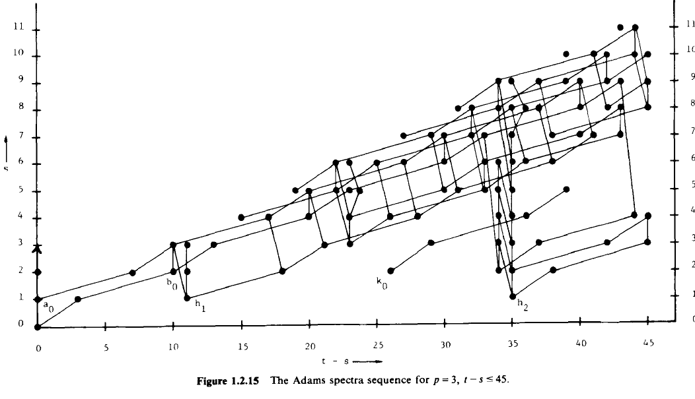
ASS (p=3)
Notes:
Miller ‘81

Slide 9
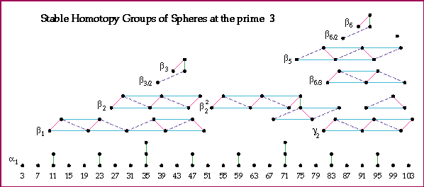
Computation: Nakamura -Tangora
Picture: A. Hatcher

Slide 10
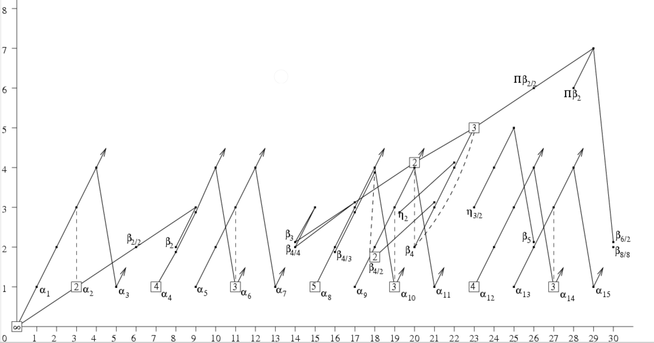
Adams-Novikov spectral sequence (p=2)
Notes:
ANSS
Pi_*BP

Slide 11
Adams-Novikov spectral sequence (p=2)

Slide 12
Adams-Novikov spectral sequence (p=2)

Slide 13
Adams spectral sequence
$$Ext_{A}^{s,t}(ℤ/p,ℤ/{p)⇒{\left(π_{t−s}^{s}\right)}_{p}}$$
$$π_{t−s}^{s}$$
Notes:
Kervaire Invariant
Browder ‘69
Barratt-Jones-Mahowald ’85
HHR ’09
Q: h_6^2 PC?
Q: d_r(h_i^2)?

Slide 14
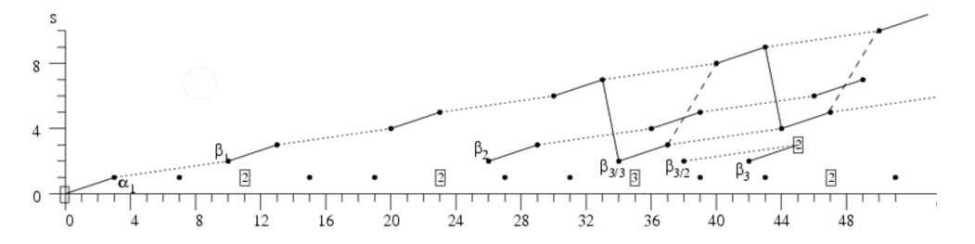
ANSS (p=3)

Slide 15
ASS (p=3)
Notes:
Miller ‘81

Slide 16
ANSS (p=3)
Notes:
Toda ’68
Ravenel ‘78 (KI for p > 3)
Q: p = 3 KI?

